Slide 1

Computational Finance and Machine Learning in Finance
Antoine Savine

Slide 2
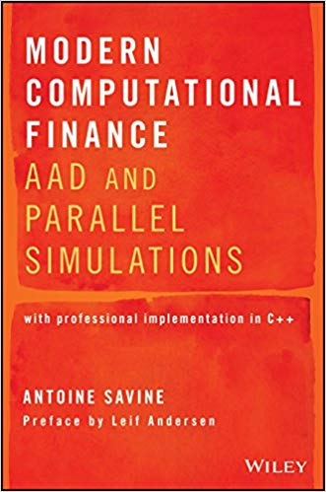
all the material: slides, code, notebooks, spreadsheets and more GitHub.com/aSavine/CompFinLecture/ your curriculum:

Slide 3

Need for Speed

Slide 4

Need for Speed
Recall from basic theory of derivatives:
Institutions must compute the value of the many transactions in their derivatives books
And their sensitivities to (many) market variables
remember sensitivities are hedge ratios
Rapidly, so they can hedge risk
Before market moves

Slide 5
Need for Speed: derivatives books
idealized world | real world
Transaction: European call option | Transactions: European calls and puts, basket/worst-of options, caps and swaptions, Bermudan (early callable) transactions, barrier and other path-dependent options, hybrids (dependent on many assets of different classes), volatility swaps, autocallables…
Model: Black & Scholes | Sophisticated models match complex risks Local and stochastic volatility (Dupire) Yield curve models (Heath-Jarrow-Morton) Many more, all the way to Gatheral’s recent “rough volatility” models
Parameters: Spot and Volatility | Many parameters reflect complex markets Interest rate curves (by maturity) Volatility surfaces (by expiry and strike) Correlations, volatility of volatility and more
Pricing and differences all analytic | Due to complexity and dimensionality: Analytics almost never feasible FDM (finite difference methods) almost always impractical Slower, less accurate Monte-Carlo the only practical solution
Pricing and risk takes a few calls to analytic functions | Pricing and risk takes thousands of differentials of prices of thousands of transactions, estimated with thousands of Monte-Carlo simulations

Slide 6
Need for Speed: regulations
Modern models, algorithms and hardware can deal with derivatives books
But regulators insist (for good reason) that we compute value and risk
Not only today
But also:
On a set of future dates: “exposure dates”
In multiple scenarios of market evolution
So even basic transactions like swaps become highly exotic
And computation requirements increase exponentially

Slide 7

Counterparty Value Adjustment (CVA)
Prominent example of regulatory risk computation: Counterparty credit Risk Adjustment (CVA)
Say I buy a 2Y ATM (spot=100) call from party A, sell it to party B
This is called “back to back trading”, in principle, risk-free
One year from now, party A defaults
A will not deliver the payoff of the call one year later
My position against B is now unhedged
I can hedge it by buying another 1Y 100 call in the market
Or implement a replication strategy
Either way, I must pay the premium of the call, again
Counterparty default may produce a loss (of a stochastic amount dependent on market on default date) but never a gain
Every time I trade with a defaultable party, I am giving away a real option
A
buy call
sell call
B
no payoff
payoff
default

Slide 8
CVA as an option
At the time T when a counterparty defaults, I have a (negative) payoff of
where V is the value, at T, of the sum of all transactions with the party (called “netting set”)
including swaps, options, exotics, hybrids, etc.
Note that V depends on the market value at T of all assets underlying to all transactions in netting set
plus path-dependencies (were Bermudans early exercised before T? were barriers hit before T? Etc.)
The payoff of the real option I am implicitly giving away when trading is therefore:
where tau is the (stochastic) time of default
this is also often written as a continuous integral
This is a complicated, hybrid option that depends on credit and the joint dynamics of all underlyers in the netting set
even when the transactions in the netting set are basic

Slide 9
CVA: pricing
CVA is priced like any other option (ignoring discounting for simplicity):
Assuming credit is independent from market drivers of the netting set:
the left term in the sum is the (risk neutral) probability of default, can be read in credit markets (Bonds, credit default swaps)
the right term is the expected loss given default (LGD) , or “exposure”
Exposures depend on the joint dynamics of all assets that affect the netting set --- so we need:
Complex hybrid models, in practice “stitching together” models of all underlying assets, with special care to remain consistent and arbitrage-free
Monte-Carlo simulations (given the high dimensionality)
Some way to compute future book values V from the simulated state of the market at T
for example with nested simulations (Monte-Carlo within Monte-Carlo)
can we do better? for example, “learn” future values from data, with machine learning?
All of this is a (very) active field of current research, see for example Huge & Savine’s Deep Analytics
The computational requirement is massive: CVA is often computed in large data centres
With better algorithms and platforms, we can compute it locally --- see Andreasen’s influential Calculate CVA on your iPad Mini
But it may still take several minutes to compute the price alone

Slide 10
CVA: risk conundrum
Regulators insist that institutions (frequently) compute CVA and incorporate it in accounts as a loss, hence “adjustment”
From one day to next, market may move and modify CVA by hundreds of millions
But CVA is part of the bank’s profit and loss account
Banks cannot tolerate such swings
Like any other option, CVA must be hedged
Compute sensitivities of CVA to all market variables, and hedge them in the market, as usual
Problem is: CVA typically depends on thousands of market variables
all the rate curves and volatility surfaces of all the currencies in the netting set
all the exchange rates and their volatility (surfaces)
plus of course all underlying assets and their volatility (surfaces)
If it takes minutes to compute one CVA price, it may take days to compute risk of one netting set
by traditional means, bump market variables one by one and recalculate, also called “finite differences”
this is far too late: we must hedge before asset prices change in fast moving markets

Slide 11

Speed is a matter of life or death
Speed (without loss of accuracy!) is a matter of survival
In addition to CVA, banks must compute (and hedge!!) similar adjustment for funding (FVA), initial margin (MVA) and many more
collectively called “XVA”, see Gregory’s classic XVA Challenge
Banks who can’t compute and hedge risks on time are out of the business
Principal focus of quantitative research and development groups is shifting towards fast models, algorithms and platforms

Slide 12


How to achieve speed: classic avenues
Improve Monte-Carlo convergence
“Better random numbers”: Sobol’s sequence
Control variates:
Antithetic: for every path, generate another with reflected Brownian
Model specific: adjust paths to hit discount factors, European options…
Many flavours of variance reduction techniques (generally problem specific)
Well known and taught all explained in Glasserman and Jaeckel’s classic books
Improvement typically (sub-)linear
Leverage modern hardware
Cache awareness
Multi-threaded programming, SIMD
GPU, TPU
Less classic, seldom taught in finance all explained in Savine’s Modern Computational Finance
Yet major (linear) improvement on modern hardware
faster

Slide 13
How to achieve speed: cutting edge
Adjoint Differentiation (AD)
We compute differentials by bumping, repeatedly recalculating value
What if we could compute value and all differentials, at once, in a time independent of the number of differentials?
We would get full risk for a time similar to one computation of the value
This is what AD and its automatic instance AAD offer: an order of magnitude improvement in speed, and the most prominent leap in computational finance since finite difference methods (FDM) in the 1990s
Recent addition to finance
Smoking Adjoints paper by Giles & Glasserman, 2006
Award-winning Bank-wide implementation in Danske Bank, 2012-2015
Not yet broadly understood or systematically taught in financial programs
Similar tech also powers machine learning (where it is called “back-prop”)
AD is the principal focus of this course
fastest

Slide 14
How to achieve speed: future tech
Rise of Machine Learning
Values and risks of trading books are (very complicated) functions of the state (market + path-dependencies)
In principle, this function can be taught to machines
In a way similar to how your phone identifies people by “looking at” them: target (identity) is a (learned) function of state (pixels on camera)
Many ideas from Machine Learning (mainly Deep Learning) are being applied in finance as a very current, very active area of research & development
May lead to another leap in computational speed
See first public milestones (all from 2018-2019):
Horvath, Deep Learning Volatility
Mc Ghee, An Artificial Neural Network Representation of the SABR Stochastic Volatility Model
Huge & Savine, Deep Analytics
even faster?

Slide 15
Summary of the course
Programming for speed: 1-2 hours
Deep Learning and back-prop: 4-5 hours
Adjoint Differentiation: 3-4 hours
Design Patterns for Simulation Systems: 1-2 hours
Parallel simulations in C++: 1-2 hours
Important note:
in these lectures, we implement basic, toy C++ code, optimized for simplicity and pedagogy
professional code, optimized for production and efficiency, is available in the curriculum
and its own GitHub repo GitHub.com/aSavine/compFinance
GitHub.com/aSavine/CompFinLecture/
your curriculum
your companion repo

Slide 16
Programming for Speed

Slide 17
Demonstration 1: matrix product 30x faster
C++ code:
GitHub.com/aSavine/CompFinLecture/MatrixProduct
Python notebook:
GitHub.com/aSavine/CompFinLecture/MatrixProductPython
Curriculum:
chapter 1

Slide 18
Demonstration 2: Dupire’s model (1992)
Extended Black & Scholes dynamics (in the absence of rates, dividends etc.):
Calibrated with Dupire’s celebrated formula: with C(K,T) = call prices of strike K, maturity T
Implemented with a (bi-linearly interpolated) local volatility matrix:
Volatility matrix: 21 spots (every 5 points 50 to 200) and 36 times (every month from now to 3y) we have 1,080 volatilities + 1 initial spot (=100) = 1,081 model parameters
Valuation of a 3y (weekly monitored) barrier option strike K=120, barrier B=150:
Solved with Monte-Carlo or FDM over the equivalent PDE (from Feynman-Kac’s theorem)
We focus on Monte-Carlo simulations here: 500,000 paths, 156 (weekly) time steps

Slide 19
Demonstration 2: Results
Implementation
C++ code exported to Excel (see tutorial ExportingCpp2xl.pdf on GitHub.com/aSavine/compFinance/xlCpp/)
Modern library design with efficient implementation (chapter 6)
Parallel implementation (chapters 3 and 7)
Sobol quasi-random numbers (chapters 5 and 6), excerpt here: medium.com/@antoine_savine/sobol-sequence-explained-188f422b246b
Advanced AAD with expression templates (chapter 15)
Hardware: quad-core laptop (surface book 2, 2017)
Performance:
One evaluation with 500,000 paths over 156 time steps take ~0.8sec
We have 1,081 risk sensitivities, take about 15 minutes to produces model risk report with linear differentiation
With AAD the 1,081 differentials are produced in ~1.5sec

Slide 20
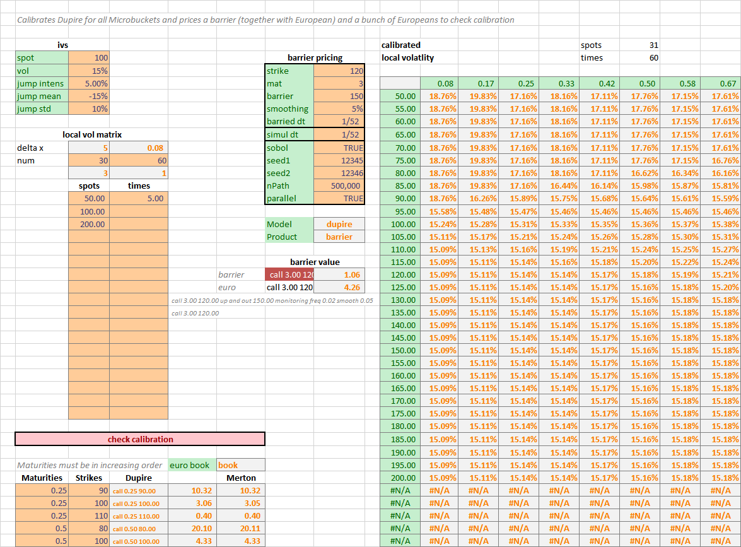
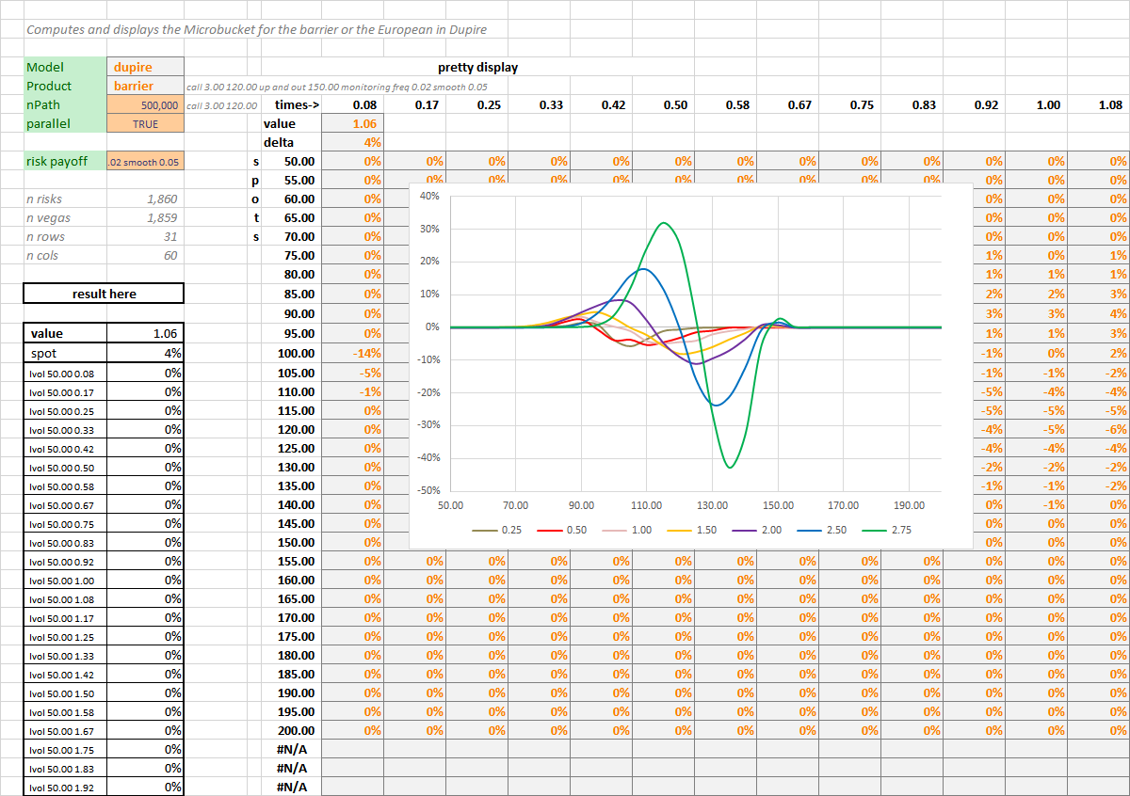
Demonstration 2: material
GitHub repo of the curriculum Github.com/aSavine/CompFinance
Prebuilt Xl addin xlComp.xll (may need to install redistributables VC_redist.x86.exe and VC_redist.x64.exe, provided)
Demonstration spreadsheet xlTest.xlxs

Slide 21
Deep Learning

Slide 22


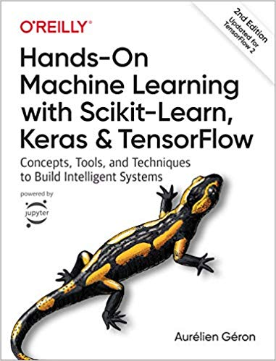
Neural networks and deep learning
We briefly introduce deep learning here
A lot of learning material is found in books, MOOCs and blogs
Quality is uneven, we recommend the following:
Andrew Ng’s lectures on Coursera
Goodfellow’s reference book
Geron’s practical introduction with TensorFlow (2nd ed)

Slide 23
Linear regression
Linear model (joint Gaussian assumptions):
Parameters:
Parameters are fitted to a dataset set of input vectors where targets are known
Fit means find parameters that minimize prediction errors
Then, the fitted model – with fitted parameters is applied to new examples to make predictions for unknown targets

Slide 24

Linear classification
Alternatively, classification problems predict discrete categories
Example: identify animals in pictures: 0: not an animal, 1: cat, 2: dog, 3: bird, 4: other animal
Regression more relevant than classification in quantitative finance
Deep learning community typically focuses more on classification
See literature for details, for example Stanford’s CS229 on cs229.stanford.edu/syllabus.html
This lecture sticks with regression
Everything that follows generalises easily to classification and the maths remain essentially identical
picture 1920x1080x24bit colour
vector of 1920x1080 pixels
Parameters:
b: vector of dimension 5
w: matrix 5 x 2,073,600
s: softmax function
softmax regression

Slide 25
Linear fit
Training set of m examples (each a vector in dimension n) with corresponding labels
Learn parameters: by minimizing prediction errors (cost function)
Note that this is the same as maximizing (log) likelihood under Gaussian assumptions, hence: are the maximum likelihood estimators (MLE) for the Gaussian model
b* and w* are found analytically, solving for
Result (“normal equation”):
Solution is analytic and unique: no local minima since C is convex (quadratic) in b and w

Slide 26
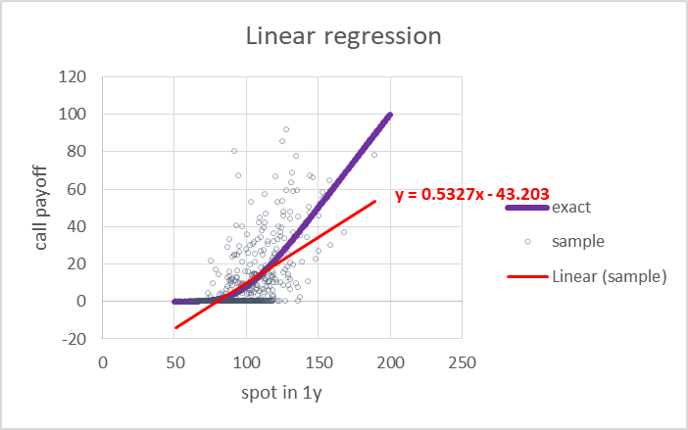
Linear limitations
We introduce an important example: the revaluation of a European call
Predict the future price in 1y of a European call strike 100, maturity 2y
By regression of the payoff in 2y:
Over the underlying asset price in 1y:
Given a training set of m paths
generated under Black & Scholes’ model (spot = 100, volatility of 20%)
We know the exact solution is given by Black and Scholes’ formula so we can assess the quality of the regression
See spreadsheet reval.xlsx on the repo Github.com/aSavine/CompFinLecture/RegressionSheet/
Linear regression obviously fails to approximate the correct function because it cannot capture non-linearities

Slide 27
Basis function regression
hidden layer
= basis functions
= features of x
Solution: regress not on x but on basis functions a of x
Example: polynomial regression
Basis functions = monomials (x is in dimension ):
1st degree:
2nd degree:
3rd degree:
Etc.
Prediction in two steps:
Start with the vector x of inputs
Compute vector of basis functions (or “features” in ML lingo):
Predict linearly in the basis functions:
Fitting: identical to linear regression on a in place of x
output layer = prediction
original features
= input layer
linear regression

Slide 28
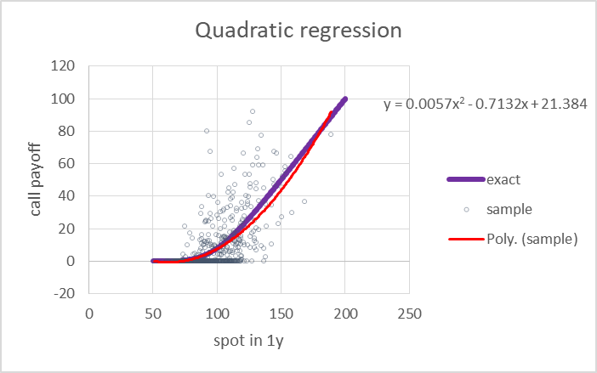
basis function regression: performance
Works nicely: quadratic regression of over approximates Black & Scholes’ formula very decently in simulated example
Remarkable how the algorithm manages to extract Black & Scholes’ pattern from noisy data
Run it yourself, reval.xlsx on the repo GitHub.com/aSavine/CompFinLecture/RegressionSheet/
This is still a linear model (in the weights) so the solution remains unique and analytic
Mathematical guarantee:
Combinations of polynomials can approximate any smooth function to arbitrary precision
Hence, detect any (smooth) non-linear pattern in data
But only with a large number of basis functions / high polynomial degree
Not limited to polynomials: same arguments apply to other bases like Fourier (harmonic) basis, spline basis, and many more

Slide 29
Curse of dimensionality
How many monomials in a p-degree polynomial regression?
Number of basis functions (dimension of a) grows exponentially in number of features (dimension of x)
Precisely:
Examples:
Quadratic regression: dimension grows e.g. from 10 to 66, from 100 to 5,152, from 1,000 to 501,501
Cubic regression: dimension grows 10 to 287, 100 ➔ 176,852, 1,000 ➔ 167,668,502

Slide 30
Explosion of basis functions
In the general case, basis is not necessary polynomial
Other possibilities include Fourier basis, spline basis and many more
Number of basis functions always explodes when dimension grows
Intuitively: we fix basis functions irrespective of data set
We expect our set of fixed basis functions to perform well with all datasets
So we need a large number basis functions
Explosion of basis functions is a computational problem: prediction and fitting become prohibitively expensive
Another problem with a large number of parameters is overfitting

Slide 31
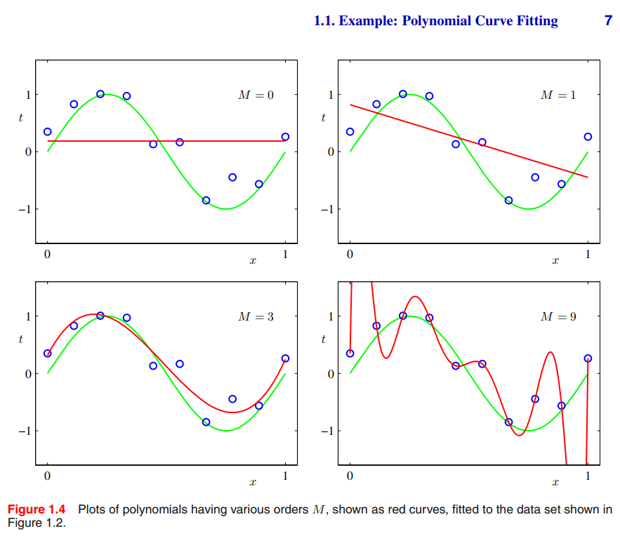
Overfitting and the variance-bias trade-off
From Bishop (2006) Pattern Recognition and Machine Learning
If you fit a linear model with n free parameters to n data points
You will find a perfect fit
But the model may not generalize well to new examples
Because it captured the noise of the particular training set
This is called “overfitting” and relates to “variance” because the estimated model strongly depends on the dataset
Variance vanishes when the size of the dataset grows
Conversely, with too few parameters, you may fail to fit data
This is called “bias” because the estimated model fails to correctly represent data even asymptotically, when the dataset grows
Trying to fit a linear model to learn call prices (a few slides back) is one example of bias
This is all properly formalized as the “variance-bias trade-off”
See for instance Bishop’s Pattern Recognition and Machine Learning
Or summary on Quora: quora.com/Does-neural-network-generalize-better-if-it-is-trained-on-a-larger-training-data-set-Are-there-any-scientific-papers-showing-it/answer/Antoine-Savine-1
Solutions exist to mitigate overfitting, called “regularization” See Stanford’s Machine Learning class on Coursera or Bishop’s book
The most obvious and effective regularization is to increase the size of the training set
Rule of thumb: at least 10 times as many training examples as the number of free parameters (“rule of 10”) – in practice we generally need much more
Point is size of training set must increase when parameter set increases, hence, number of training examples also explodes in high dimension

Slide 32
ANN: learn basis functions from data
BASIS FUNCTION REGRESSION
hidden layer = arbitrary set of basis functions
pre-processing = not part of the model, no learned parameters
ANN
hidden layer = learned set of basis functions
part of the model, subject to trainable parameters
output layer = prediction
output layer = prediction
linear regression over basis functions
linear regression over basis functions
identical

Slide 33
Learn features from data
Instead of a fixed set of basis functions, irrespective of data (hence we need many of those)
We fix the number of basis functions (recall, also called “features”)
And learn the “best” ones from data
So we end up with features that adapt to data (hence we don’t need so many of those)
How do we learn basis functions a from the data?
Parametric family of basis functions: ➔ each basis function ai is a parametric function of the same vector of inputs x each with different parameters θi
Learn parameters (along with the weights w and bias b of regression) by minimization of the cost (e.g. sum of squared errors)

Slide 34
Perceptron
Perceptron = (by far) most common choice of parametric family of basis functions
Each basis function ai is some non-linear scalar function g of a linear combination of the xs In other words, each feature is a different combination of the same xs, activated by a given scalar function g
g: scalar function called “activation”, applied element-wise to the vector
Each is a vector of parameters of dimension , called “weights” and each is a real number parameter (“bias”)
Hence, if is a matrix and is a dimensional vector
Then, the vector of basis functions is where g is a scalar function applied element-wise to the vector
The activation function g
Is, in principle, arbitrary
Must be non-linear or we are back to a linear regression (a linear combination of linear functions is a linear function of the inputs)
(Must satisfy some mild technical requirements for the perceptron to represent any function)

Slide 35
Perceptron (2)
Perceptrons have two major benefits:
Computational
Perceptron networks are sequences of matrix operations
(Matrix products followed by element-wise activations)
Executed very efficiently on modern parallel CPU, GPU and TPU
Representational
Perceptrons can represent any function
(in the asymptotic limit of an infinite number of basis functions, also called “units”)
Not unlike polynomial or Fourier bases
This is called the “Universal Representation Theorem”

Slide 36
Perceptron (3)
…
…
output layer: combination of basis functions
hidden layer: compute basis functions

Slide 37
Prediction with perceptrons
Prediction in two steps
Step 1 (hidden layer): feature (=basis function) extraction inputs x (dim n0) → basis functions a (dim n1)
Parameters: matrix in dimension and vector in dimension
The activation function g is scalar and applied element-wise on the vector
Step 2: (output layer): linear regression basis functions a (dim n1) → prediction (real number)
Parameters: row vector in dimension and real number
Unified notation for both steps = feed-forward equation or
For layers l = 0 and 1
With the notations and parameters

Slide 38
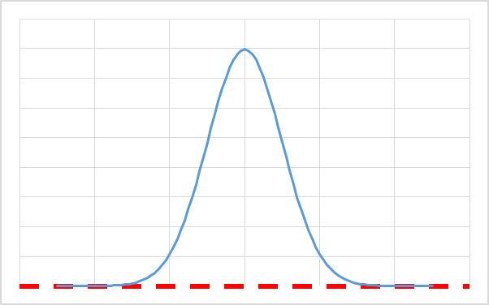
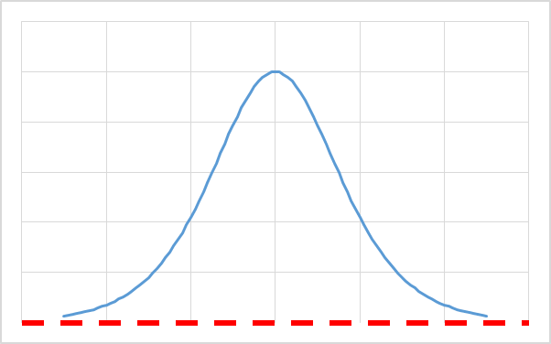
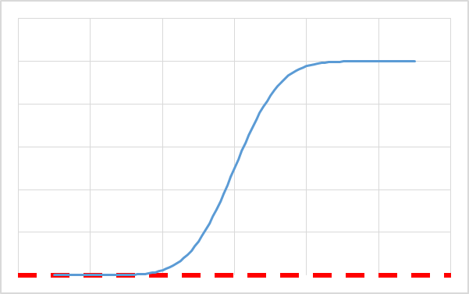
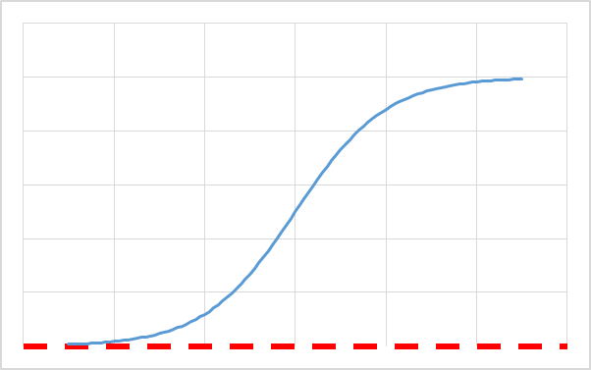
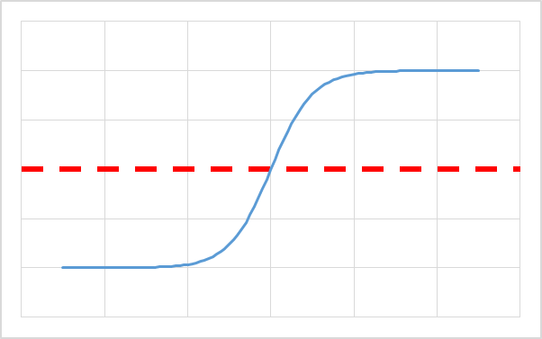
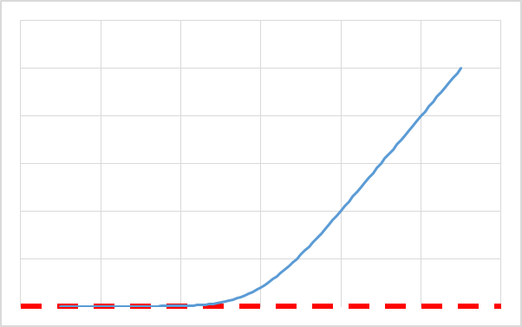
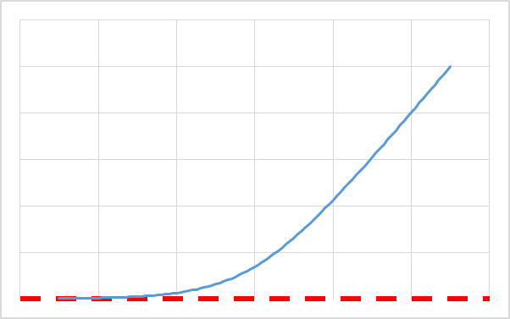
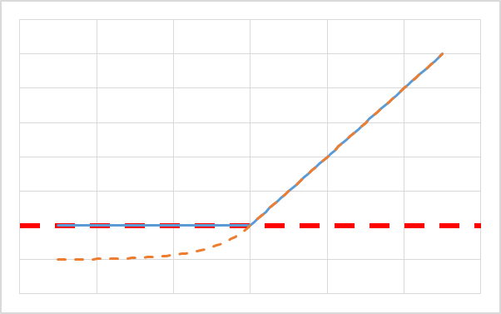
Activations
The hidden activation function g must be non-linear – here are the most common choices :
*antisymmetric around zero, saturates slowly on the sides default choice is ELU
Context | Intuitive solution | Cheaper computation | Improves training*
Activate localized spheres Application: interpolation/spline | Gaussian density | Derivative of sigmoid
Activate above threshold Application: probability/classification/ flat extrapolation | Gaussian distribution | Sigmoid | Hyperbolic tangent
Activate proportionally to distance to threshold Application: regression with linear extrapolation | Integral of Guassian (Bachelier) | SoftPlus = Integral of sigmoid | RELU / ELU
derivative
integral

Slide 39
Computation graph and complexity
Input layer l=0
Hidden layer l=1
Output layer l=2
Complexity
To the leading order (ignoring activations and additions) We have 2 matrix by vector products
Hence quadratic complexity
To simplify when all layers have n units, complexity ~
More generally, with L layers, complexity ~
Complexity is linear in layers, quadratic in units
feed-forward equation

Slide 40
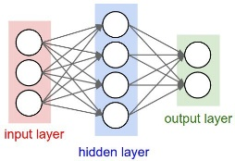
Perceptron: summary
Prediction
Predict target y by linear regression on a set of features a of the input x (of dimension ):
The features are not fixed, they are parametric functions of x, with learnable parameters:
The most common form is the Perceptron:
Features are combinations of inputs, activated element-wise:
Computational benefits: matrix operations faster than the sum of their operations on modern hardware
Universal Representation Theorem: can asymptotically represent any function
Historical legacy and some similarity with how human brain works
Both feature extraction x→a and regression a→y are instances of the feed-forward equation:
The learnable parameters of the network are all the connection weights (linear coefficients) in the extraction and regression steps:
Matrices of weights in dimension
Vectors of biases in dimension
The computation graph is of the familiar shape
The complexity is
dominated by matrix by vector products
linear in layers, quadratic in units

Slide 41

Perceptron: training
“Learn” or “train” = fit the parameters of the perceptron to data
Given a “training set” of m training examples, each with an input vector x and a known target y (hence, “supervised learning”)
Set all learnable parameters to minimize prediction errors
Note that learnable parameters are no longer limited to regression coefficients, they also include feature extraction (hidden layer)
Learnable parameters are all the connections between units of successive layers
They are represented by the edges of the computation graph
Formally, they are the union of matrices W (and biases b) in the sequence of feed-forward equations
So we are looking for the solution of
Or, cancelling gradients: --- unfortunately:
The solution is no longer analytic, a numerical minimization procedure is necessary
C is not even convex in W and b, so the gradient equation has many solutions, corresponding to saddle points and local minima
There exist no algorithm guaranteed to converge to the global minimum The best we have is guarantee of convergence towards a local minimum Incredibly, this is good enough in practice in many cases of practical relevance

Slide 42
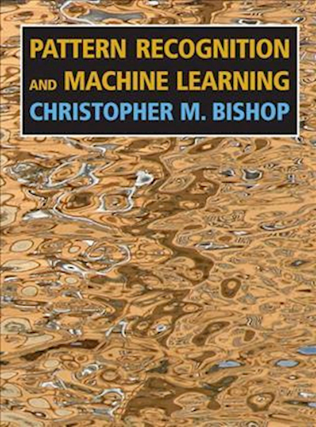
More on regression, basis functions and ANNs

Slide 43
Batch prediction
Single example prediction sequentially applies the feed-forward equation
from vector of inputs to output
To predict multiple examples 1,...,m we could:
Sequentially run feed-forward equations with to find , then with to find , etc.
Or, we could run feed-forward equations once with (stacking examples in columns)
to find (with results also stacked in columns)

Slide 44
Batch prediction (2)
Feed-forward equations remain absolutely identical
as are now matrices, stacking batches of examples in column vectors
Adding a vector v to a matrix M means: add v to all columns of M This is called “broadcasting” in programming languages Implemented by default in Python’s numPy But not in C++
Why implement batch prediction?
Complexity is identical: to process a matrix by matrix product at once or as a sequence of matrix by vector products, column by column, is identical
But modern hardware (CPU, GPU, TPU) is highly optimized for SIMD processing
SIMD: Single Instruction, Multiple Data: apply the same instructions to a lot of different data simultaneously
On GPU, (reasonably sized) batch prediction takes a time similar to one single prediction!
In all that follows, for simplicity, we consider single example predictions where as are vectors
All equations apply identically with batch predictions with as matrices with m (batch size) columns
Practical implementations always predict in batches

Slide 45
Deep learning
Deep learning = ANNs with multiple hidden layers --- exactly as before:
Input layer is set to the input vector x:
Successive layers are computed from the previous layer by application of the identical feed-forward equation:
Prediction is the last (output) layer:
The only difference is: we now have multiple hidden layers 1, 2, ..., L-1
So the mechanics are identical to before
The more interesting question is: why would we want more than one hidden layer?

Slide 46
Multi-layer perceptron (MLP)
Input layer l=0
Hidden layer l=1
Hidden layer l=2
Hidden layer l=3
Output layer l=4
Prediction: feed-forward equations
Parameters:
Number of parameters:
Complexity
Training: find all to minimise cost
Use iterative algorithms compute all D differentials on each iteration
Key: quickly compute large number D of differentials
feed-forward equation

Slide 47
Deep learning: rationale
Universal Representation Theorem states that all functions are attainable with a single hidden layer
This is an asymptotic result, as the number of units in the hidden layer increases to infinity
In practice, we have a limited “computational budget” so we have only so many units
It has been empirically observed, repeatedly, that:
Given a fixed computational budget
Networks with multiple layers (of fewer units)
Perform (exponentially) better than those with one layer (with more units)
This is the basis of modern Deep Learning
This is not (yet?) formally demonstrated
It is even unclear how to formalize what it is exactly we want to demonstrate?
But deep learning was repeatedly validated with empirical success
And we can try to explain why with heuristics and intuition if not formal maths

Slide 48
Learning by composition
The heuristic rationale is:
Deep Learning introduces function composition, allowing nets to represent a larger space of functions with a limited number of units
With one hidden layer:
Each basis function is an activated combination of the input units
So additional hidden units allow the network to learn a larger number of basis functions of the same shape
With multiple layers:
Each unit in a layer is a function of all the units in the previous layer
a1 is a function of a0=x, a2 is a function of a1, etc.
In the end, we regress linearly on the penultimate layer (“basis layer”)
Whose units are basis functions of basis functions of basis functions ... of the inputs
So, instead of simply increasing the number of possible combinations of the inputs
Deep nets learn to compose functions to find optimal basis functions for regression
Composition allows them to attain a larger, richer space of functions with a limited overall number of units
Hence, giving nets a higher representational power for a fixed computational budget

Slide 49
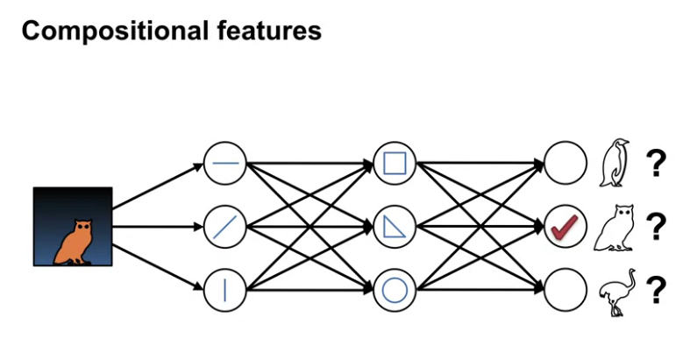
Example : image recognition by deep learning
Image from Coursera’s
~stellar~
Reinforcement Learning Spec
by University of Alberta
First layers(s) activate modular, reusable basic shapes: horizontal, vertical, diagonal edges
Middle layers combine these features into composite shapes: here, squares, triangles, circles could be eyes, body shape, legs
Output layer combine these features into objects to be identified

Slide 50
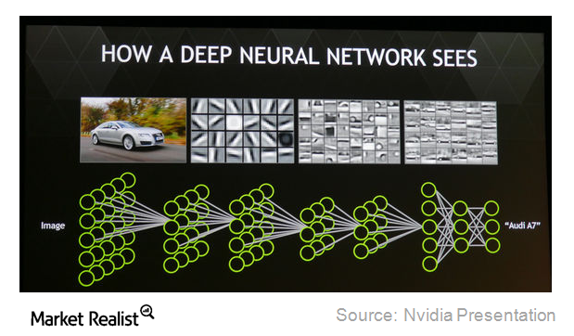
Another (more realistic) example
Early layers detect low level features: mainly, edges, horizontal, vertical, diagonal...
Subsequent layers combine them into more complex features: wheels, windshields, doors, windows, etc.
Late layers combine these into cars The degree of activation of different cars in the output layer gives the probability of identification

Slide 51
Deep learning heuristics
Benefits of depth have been repeatedly illustrated by spectacular results, including:
Image recognition (with deep “convolutional” nets)
Time series prediction (with deep “recurrent” nets)
Natural Language Processing, Neural translation and speech recognition
And much more, out of scope in this lecture
But we don’t have a formal demonstration (yet?)
Such formalism would not only confirm empirical results
But more importantly: guide neural net architecture and hyper-parameters
At present, these are set heuristically, and/or from experience:
For example, for regression problems (like we have in finance), performance sharply improves from 1 to 3-5 hidden layers, stabilizes thereafter
On the contrary, deep convolutional nets in computer vision typically include hundreds of layers

Slide 52
More deep learning heuristics
Similarly, training performance is not guaranteed
Loss is non-convex in weights
No algorithm exists to find global optimum of non-convex functions, and probably never will
Empirically, it has been “shown” that local optima are “OK”
What does that mean exactly?
Deep learning is validated by (undeniable) results, not mathematics
Is it good enough? This is an open question
Many heuristics were designed to better train networks, including:
Careful initialization of weights: the quality of a local optimum directly depends on starting point
Batch-normalization: normalize mean and standard dev between layers
Dropout normalization: randomly drop connections to reduce effective number of parameters
Inclusion of momentum and adaptive learning rate on different dimensions when applying gradients
Skip layers (more on that later)
and much much more

Slide 53
More deep learning heuristics (2)
None of those multiple heuristics is guaranteed to help formally
But they tend to help immensely in practice
As for depth, we can’t (yet?) formalize their contribution
But we can understand it intuitively
This is out of scope in this lecture
We refer to Andrew Ng’s highly recommended Deep Learning Specialization on Coursera

Slide 54
Back-Propagation

Slide 55
Elements of multivariate calculus
We will derive the differentials of cost functions in neural nets, and learn an algorithm to compute them extremely quickly
This algorithm, called “back-propagation”, or often “back-prop”, is what enables deep net training in reasonable time
Deep learning would not be feasible without it
Further, we will see that back-prop is a only a particular case of a more general algorithm, applicable to any calculation that computes a scalar result from a (large) vector of inputs and/or parameters called “adjoint differentiation” (AD)
Modern frameworks apply back-prop and AD automatically, behind the scenes
In its most general form, this is called AAD: the first A stands for Automatic
Since practical neural nets are sequences of matrix operations: matrix product and element-wise activation
We have to apply matrix differential calculus
Hence, we (briefly) introduce a few results we need to derive basic back-prop, for a more complete reference, see for instance:
Mathematics for Machine Learning by Imperial College on Coursera

Slide 56
Gradients
Consider a scalar function of a vector:
We call gradient of f on x and denote the column vector of its derivatives:
derivatives in rows
function in column

Slide 57
Gradients: key properties
Gradient cancels on minima and maxima
Reciprocal is not true: zero-gradient points may be global optima, local optima or saddle points
Only for convex (concave) functions, zero-gradient points attain global minimum (maximum)
The gradient vector is the direction where the slope of f is steepest
Demonstration: to the 1st order Hence, for a fixed step size :
- steepest ascent is in the direction of cos=1 - steepest descent is in the direction of cos=-1 - f is unchanged moving orthogonally to cos=0
This two properties form the basis of a fundamental optimization algorithm: gradient descent
Repeatedly move by small steps (called “learning rate”) in the direction of steepest ascent/descent given by gradient until gradient cancels
Guaranteed to converge to global optimum for convex functions local optimum or saddle point otherwise given technical conditions on progressively shrinking learning rate
steepest descent
f(x)
f unchanged
x
steepest ascent

Slide 58
Matrix gradients
The gradient of f(x) has the same shape (nx1) as x
We want the same property for scalar functions of matrices:
We denote the matrix of its derivatives, of the same shape (nxp) as M

Slide 59
Jacobians
Consider a vector function of a vector (or a set of p functions of x, x being of dim n)
The matrix of the derivatives of the p functions to the n inputs is called Jacobian matrix
Conventionally, Jacobians are often written with functions in rows and derivatives in columns:
This is inconsistent with gradients, written the other way Hence, confusing
In this case, is of shape (pxn)
And you can check that the chain rule is written: (outer function first)
functions in rows
derivatives in columns

Slide 60
Jacobians the other way
We will write Jacobians the other way, consistently with gradients:
This is consistent with gradients
Gradient = Jacobian of one-dimensional functions
Jacobian = horizontal concatenation of gradients
In this case, is of shape (nxp)
And you can check that the chain rule is written: (inner function first)
derivatives in rows
functions in columns

Slide 61
Jacobians of linear functions
If is linear, i.e. where A is a matrix of shape (pxn)
Then, you can convince yourself that its Jacobian matrix (with derivatives in rows) is the constant:
and not A (which is maybe why people like Jacobians the other way around…)
=
*

Slide 62
Jacobians of element-wise functions
Consider a scalar function:
We apply f element-wise to a vector x of dim n to obtain another vector of dim n:
Then, the Jacobian of f is the nxn diagonal matrix of element-wise derivatives:
=

Slide 63
Vector functions of matrices
Consider now a vector function of a matrix:
In principle, its “derivative” is a 3D tensor of shape (nxpxq):
In the linear case where , and v is a constant vector of size p=q
We have and
=
*

Slide 64
How to train your network
Recap: we have an ANN of the MLP form implementing the following sequence of feed-forward computations:
Starting with inputs
Sequentially compute then (for l = 1, 2, ..., L: feed-forward equations)
To make predictions
We have a training set of m independent samples for the inputs x (each in dim n0), along with corresponding labels
We want to train the ANN so it outputs the “best” predictions for y knowing x, that is
By definition, conditional expectation is the function closest in the sense of least squares:
Asymptotically in the number m of training examples:
Asymptotically in the number of units (recall, neural nets encode functions in weights):
Therefore, we must find the parameters W* and b* minimizing mean square prediction error on the training set:

Slide 65
Bad news good news
There is no analytical solution for the optimal weights (unlike with linear regression)
The cost C is a non-convex function of the weights W biases b (in what follows we just call “weights” all the parameters)
An algorithm guaranteed to find the minimum of a non-convex function does not exist, and probably never will
So, the problem of training ANNs cannot, in theory, be resolved
This realization caused mathematicians to step away from deep learning in the 1990s
Deep learning was revived recently by engineers along the lines of “this is not supposed to work, but let’s try anyway and see how we can take it”
And we all know it did work and produced spectacular results
The starting point is gradient descent:
Choose initial weights randomly
Take repeated steps, changing weights
by a small amount called “learning rate”
along the direction of steepest descent, which we know is the direction opposite to the gradient
Many heuristic improvements were made to improve and accelerate learning, but none is guaranteed to converge
However, we understand the intuitions and take comfort in that they work remarkably well in a multitude of contexts

Slide 66
Differentials by finite differences
Optimization algorithms
All learning algorithms start with a random guess and make steps opposite to the current gradient
Our job is compute the gradients and of the cost C, repeatedly
Our goal is to do it quickly
Gradients by finite differences (FD):
First compute the cost with the current weights, making predictions for all training examples
To compute the sensitivity of the cost to each scalar weight or bias :
Bump the parameter by a small amount
Re-compute the cost , repeating feed-forward calculations for all training examples
The derivative to the bumped weight is approx.
Repeatedly re-compute predictions, bumping one weight at a time
Linear complexity in the (potentially immense) number of weights, therefore not viable
But some very desirable properties

Slide 67
Automatic derivatives with FD
Implementation is straightforward with little scope for error
Importantly, FD differentiation is automatic
Developers only write prediction (feed-forward) code
FD computes differentials automatically by calling the feed-forward code repeatedly
Developers don’t need to write any differentiation code
More importantly, FD automatically synchronises with modifications to feed-forward code
More complex layers: convolutional, recurrent, ...
Tricks of the trade to train deep nets faster and better:
Dropout: randomly drop connections between units
Batch Norm: normalize the mean and variance on all layers
And many more
See e.g. Coursera’s Deep Learning Spec
All of these modify feed-forward equations and code
Manual differentiation code would have to be re-written and re-tested accordingly, every time
This is painful and prone to error
Automatic differentiation (obviously) guarantees effortless consistency

Slide 68
Analytic differentials in MLPs
FD is a general, automatic differentiation algorithm but it is too slow for training ANNs
Lets see if we can do better with analytic differentiation
We will derive analytic differentials for linear regression first
Then, generalize to shallow neural nets, with a single hidden layer
Finally, generalize to vanilla deep nets
Later, we will generalize to any kind of network and even any (scalar) computation
And see how to compute those differentials automatically, behind the scenes, like with FD, but an order of magnitude faster

Slide 69
Analytic differentials in MLPs: Framing
We know all the current parameters and or in matrix form and
The activation function(s) are fixed and known
We call them “hyper-parameters” or non-learnable parameters
We also know their derivatives -- recall these are scalar functions, applied element-wise
Prediction is obtained from example
By a sequence of feed-forward equations: combination + activation
The loss for example i is the (squared) prediction error
The cost for the training set is
Our goal is to compute all the and or in matrix form and

Slide 70
Differentials for single example or batch
We will compute and
Then and
The complexity is the same
To compute differentials of losses of single examples and sum them up
Or compute differentials of a batch of examples at once
However, batch computation is more efficient on modern hardware
Practical implementation are always batch implementations
We start with a single example to simplify calculus
And drop the example index (i) to simplify notations

Slide 71
Differentials: linear regression
input
Comments
Derivatives are computed in the reverse order
Parameter derivatives all depend on
Hence, we first compute , then parameter derivatives
To compute derivatives, we must first know
So we must make a prediction (“forward pass”)
before we compute derivatives (“reverse pass”)
output
c
loss
chain rule

Slide 72
Differentials: shallow net
combination
activation
Comments
We compute derivatives in the reverse order, systematically reusing previous computations
We reuse known from difference of regression layer
The chain rule dives us
And then:
(with a bit of effort)
and
We need values of z and a So in the prior forward pass, we must remember all intermediate results
input
output
c
loss
chain rule

Slide 73
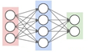
Differentials: deep net
layer l+1 activation
combination
layer l activation
output
c
loss
parameters for this layer
derivatives to previous layer so back-propagation of derivatives can continue

Slide 74
Back-prop: single example, vanilla net
Forward pass: predict and store
Start with input layer
Recursively compute (with feed-forward equations) and store combinations z and activations a of layer l, from l=1 to l=L
note activation g may de different on every layer, for instance g=id on the output layer
Pick prediction and loss
Backward pass: compute derivatives of loss c in the reverse order
Start with output layer
Recursively compute for layer l, from l=L to l=1, hence in the reverse order, knowing
Derivatives of c to parameters of layer l:
Derivatives of c to layer l-1 so back-prop may proceed:

Slide 75
Back-prop: efficiency
Reversing the order we reuse derivatives to next layer inputs = current layer outputs, to compute derivatives to current layer parameters and inputs
Therefore, we only differentiate current layer operations to produce derivatives
Recall complexity of forward pass
To the leading term, one matrix by vector product (of complexity quadratic in units) per layer
Plus, negligible (linear) addition of bias and activation
Complexity of backward pass:
One matrix by vector product (of complexity quadratic in units) for derivatives to previous layer
One outer product (also of complexity quadratic in units) for derivatives to weights
Plus, negligible (linear) element-wise multiplication and activation derivatives
Hence, back-prop computes all (maybe thousands or even millions of) derivatives with complexity only 3 times a forward pass!

Slide 76
Exercise: batch back-prop, vanilla net
The only way to really get back-prop is re-derive it yourselves
The exercise is re-derive back-prop in the vanilla net, but for a batch of m examples to leverage modern, parallel hardware:
Inputs: the m examples stacked in the m columns of the input matrix
Feed-forward equation: same as before
except z and a are no longer vectors, but matrices with m columns
Prediction: a row vector in dimension m
Cost:

Slide 77
Solution
Seed:
Recursion for l=L to 1:
Combination:
Weights:
Biases:
Recursion:

Slide 78
Generalization
We have so far studied “vanilla” neural nets
Compute current layer l from previous layer l-1 in two matrix operations (or ops, following TensorFlow nomenclature): a combination followed by an activation
Each layer admits two sets of parameters, or connection weights: the matrix and the vector
The output layer is a real number (the prediction)
The loss is the square prediction error:
Excluded components present in real-world ANNs like:
Improvements in training speed and stability like batch-norm or dropout ➔ new ops, more than 2 per layer
Convolutional or recurrent nets heavily used in computer vision or natural language processing ➔ yet different ops
Classification nets ➔ is a vector and is an arbitrary scalar function

Slide 79
General ANNs
We generalize the formalism of ANNs as follows:
Starting with the vector in the input layer, as previously
Apply a sequence of L vector-to-vector transformations (or ops) , each parameterized by its vector of parameters
The ops in the sequence are arbitrary, but every transformation must be a function of the previous vector only (for now)
We call ops these vector-to-vector transformations --- the name comes from TensorFlow
Ops are algebraic building blocks: product by matrix, element-wise scalar function application, convolution, etc.
Jacobians and of all ops are known --- TensorFlow ops require code to produce Jacobians
l is no longer the index of the layer, but the index of the op For example, vanilla nets have 2 ops per layer: a combination, followed by an activation – general nets may have more
The vector is the collection of all scalar parameters to op , including elements in matrices and vectors For example, the matrix product step in vanilla nets is parameterized by a matrix, which we represent flattened in a vector
Pick the prediction vector and arbitrary (but, importantly, scalar) loss

Slide 80
General back-prop
Applying the same steps we used to derive back-prop for vanilla nets, we obtain a general back-prop algorithm:
Perform a forward pass, store all intermediate results
Seed with the derivative to the output layer:
Back-propagate derivatives with the chain rule, knowing
Parameter derivatives:
Compute derivatives for recursion:

Slide 81
Adjoints
For a given final scalar result c, we conveniently
define as the adjoint of some (real number, vector or matrix) x
and denote
the derivative of c to x:
Note that the adjoint x is of the same shape of x:
If x is a real number, so is its adjoint
If x is a vector, its adjoint is a vector of the same size
If x is a matrix, its adjoint is a matrix of the same dimensions
Then, the back-propagation equations may be written more compactly:
Parameter derivatives:
And recursion:

Slide 82
Adjoint differentiation
forward pass
An op transforms input into output a.k.a feed-forward equation
Corresponding adjoint equation computes derivatives of input from those of output
And we accumulate parameter derivatives on the way
backward pass

Slide 83
Adjoint differentiation (2)
Performance:
For each application of an op in the forward pass
We have two matrix by vector multiplications in the backward pass, of quadratic complexity
Provided ops are of quadratic complexity in their inputs/outputs (like matrix by vector product)
Backward pass computes all derivatives in about 3 times a forward pass
Manual implementation:
The general formulation of back-propagation
Gives a “recipe” for writing adjoint code by hand
Quite literally, an algorithm for writing code, hinting that the process may be automated
The general formulation of back-propagation
Seed the adjoint of final result
Going through ops in the sequence, in reverse order:
Compute adjoint of parameters
Recurse

Slide 84
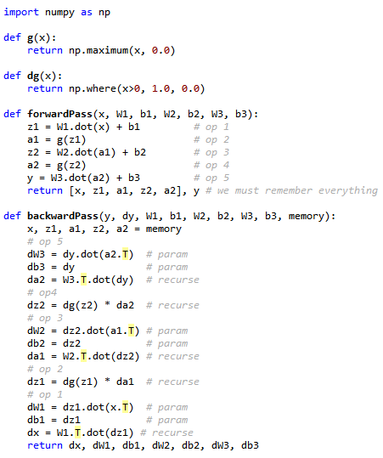
Manual adjoint differentiation
Example:
prediction and derivation code in numPy for a vanilla net with 2 hidden layers (ReLu activation)
GitHub.com/aSavine/CompFinLecture/Python/vanillaNetNP.py
We applied to the letter the general back-prop algorithm
Coding all adjoint equations in the reverse order
Code is hard to write, read, tedious and prone to error
Screams to be automated
Since we followed a recipe to write this code
It should be possible to write code that follows the recipe

Slide 85
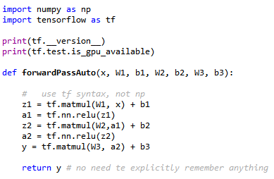
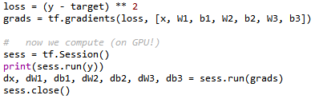
Automatic adjoint differentiation
Here is the same code in TensorFlow:
GitHub.com/aSavine/CompFinLecture/Python/vanillaNetTF.py
We only code the forward pass
On execution of our code, TF does not compute anything
All it does is build computation graph = sequence and dependency of ops in the calculation
Then, we ask TF to run the forward pass (on GPU!)
And --with a call ro tf.gradients() the adjoint pass (also on GPU)
Since TF has the graph in memory, it knows the sequence of ops
So TF can easily traverse it in reverse order and accumulate adjoints
Recall, Jacobians of all ops are hard-coded
TF does all this automatically, behind the scenes

Slide 86
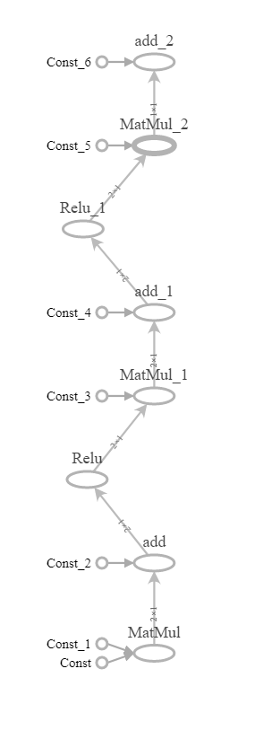
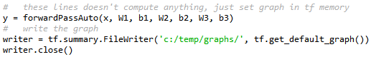
Computation graphs
AD is automated by building computation graphs in memory
Calls to TF functions don’t calculate anything, they build nodes in TF’s computation graph
You may visualize the graph with TensorBoard

Slide 87
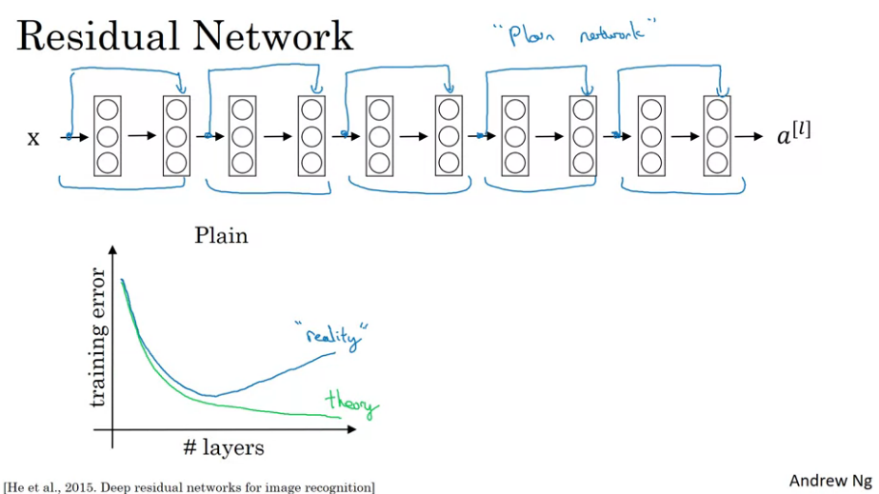
Adjoint accumulation
We need one more thing to make back-prop fully general
Many networks implement parameter sharing, meaning that and may have common elements
To compute derivatives to shared parameters, we must sum-up their contributions to different ops (You may demonstrate this as an exercise, although we are going to the bottom of this later with AAD)
Similarly, some nets implement skip layers
Means not only an input to but also some future
For instance, He and al.’s “res nets” Who won 1st place in ILSVRC 2015 and COCO 2015
(We also used this in financial nets)
So back-prop must accumulate adjoints instead of writing them:
And all adjoints must be initialized to zero before back-prop
image from the Deep Learning Specialization on Coursera

Slide 88
Final general back-prop algorithm
Perform a forward pass, store all results of all ops
Seed
Zero all adjoints
Initialize the final result’s adjoint
Recursively (from the end) accumulate adjoints, knowing
Parameter derivatives:
Recursion:

Slide 89
Reverse order magic
We have seen that back-propagation computes a multitude of derivatives with spectacular speed
Around 3 times a forward pass
By reversing order of calculation for the adjoint pass
When we compute we already know
So we can compute as a function of
And we only need differentiate one op:
We don’t need to differentiate the whole network every time
This may give the impression that reversing order is only about computing adjoints one from the other
This impression, however, is wrong: there is an inherent efficiency to reversing order, at least for scalar computations (where the end result to be differentiated is a real number)

Slide 90
Reverse order magic (2)
Forget neural nets, parameters, losses and consider the following calculation computing a scalar result y from a vector x, through successive transformations of x through a sequence of ops
Later, we will see that any calculation can be decomposed into a sequence of ops like this
Recall, ops are vector to vector transformations:
Product by a matrix
Element-wise application of a scalar function
Convolution
...
Ops are limited in number, their Jacobians are known and they are building blocks to all calculations

Slide 91
Reverse order magic (3)
We want to compute the gradient of y to x
By the chain rule:
Where we highlighted what are matrices (Jacobians) and what are vectors (Gradient)
The reason why the rightmost Jacobian is a gradient is that the calculation is scalar: is a real number, not a vector
Which is the major assumption here: back-prop and AAD apply to scalar calculations: the final result must be a real number (actually, back-prop is more efficient than forward prop as long as dim(y) < dim(x) as we will see)

Slide 92
Reverse order magic (4)
direct
This matrix product:
Can be computed left to right (direct order) or right to left (reverse order)
reverse
direct order
reverse order
Compute
Then all the way to
We forward-propagate Jacobian matrices to x from to
Every time, we multiply matrices to obtain matrices
Complexity of matrix product is cubic
Compute
Then all the way to
We back-propagate adjoint vectors from to
Every time, we multiply matrices with vectors to obtain vectors
Complexity of matrix by vector product is quadratic

Slide 93
Reverse order magic (5)
Hence, reversing the order of calculation decreases complexity by and order of magnitude
The cost is memory:
Recall for instance the adjoint equations for recursion:
To execute them in reverse order,
Either all Jacobians must be computed during the forward pass and held in memory
Or, all the results must be stored in memory
We assumed the second option for simplicity so far, in reality, first option is often better
Hence, back-prop consumes vast amounts of memory in return for spectacular speed

Slide 94
Conclusion
Reversing order of calculation for differentiation makes it an order of magnitude faster, in return for memory consumption
Computing differentials this way is the same as accumulating adjoints
Back-prop is efficient and not only because of “telescopic” parameter derivatives
The general back-prop algorithm is called Adjoint Differentiation or AD
Its automated implementation is called Automatic AD or AAD
We will now generalize it to any calculation, and code it in C++ ourselves
First, let us demonstrate some important application of ANNs in derivatives finance

Slide 95
Training

Slide 96
Gradient descent (GD) and friends
Back-prop computes gradients of cost C to all learnable parameters quickly, efficiently and accurately
We can now train models by following gradient descent to find the “best” set of parameters to fit a training set
Initialize parameters randomly
Since cost is non-convex, initialization is super important: it determines what local minimum we eventually hit
Best (heuristic) practice = Xavier-He initialization
Initialize all biases to 0
Initialize all weights in to random Gaussian numbers with mean zero and variance or
Implemented in TensorFlow as the VarianceScaling initializer
Repeatedly compute gradient of cost (by back-prop) and modify parameters accordingly
where is the learning rate on iteration t

Slide 97
Robbins-Monro theorem and Stochastic GD
This algorithm – called gradient descent (GD) – is guaranteed to converge to a point where gradient is zero aka a local minimum or a saddle point as long as the learning rate decreases “fast but not too fast”, formally: and
In practice, the learning rate is often kept constant because hovering around a local minimum doesn’t hurt much
Perhaps surprisingly, this result also holds when applying an (unbiased) estimate of the gradient in lieu of the gradient:
where and the successive are independent and .i.d.
So, on every iteration, we can compute and apply the gradients of one randomly picked example, in place of the whole training set
This is called Stochastic Gradient Descent (SGD) and massively improves training speed for large training sets
In practice, we randomly pick not one example, but a small number of examples (typically: 128, 256, 512 or 1024)
Computes almost as fast on modern GPU
Reduces variance
Called “Mini-Batch Gradient Descent”

Slide 98
Heuristic improvements and ADAM
Recent (heuristic) improvements to SGD include:
Momentum: apply (exponentially weighted) average of recent gradients in lieu of current
RMS-Prop: normalize gradients by (exponentially weighted) standard deviations
The sum of these improvements is implemented in the ADAM algorithm
Currently considered best default for deep learning
Implemented in TensorFlow (tf.train.AdamOptimizer)
Heuristically “adapts” learning rate of various parametetrs depending on average and variance of gradients
Somewhat similar to second order optimizers a la Newton, without related complexity
Out of scope here, we recommend chapter 8 of Goodfellow’s Deep Learning book for a complete review
www.deeplearningbook.org

Slide 99
Deep learning in finance

Slide 100
Milestones
Deep Learning in derivatives finance is arguably the hottest topic of current research -- Milestones so far (all dated 2018-2019) include:
Learning derivatives prices
McGhee (2018) trained a net to compute SABR prices, ultra fast and more accurate than Hagan’s original approximation
Ferguson and Greene (2018) trained a net to price basket options with inputs including correlation
Horvath and al. (Deeply Learning Volatility, 2019) built a net for pricing options with rough volatility -- This is particularly significant because:
There exist no alternatives for pricing with rough vol other than Monte-Carlo
Allows efficient, industrial calibration, pricing and risk management with rough vol
So far, rough vol was restricted to academic circles due to absence of efficient pricing
Learning future prices and risks of derivatives transactions, netting sets or trading books
Huge and Savine (Deep Analytics, 2019) established a DL-based methodology
for fast and accurate computation of future prices and risks
of arbitrary portfolios in arbitrary models
Also established differential regularization to significantly improve the performance of financial neural nets
Training derivatives hedging agents with Reinforcement Learning (RL) – Hans Buhler and al, Deep Hedging, 2018

Slide 101
More TensorFlow
We use TensorFlow to train pricing nets, we have already experimented with it -- TensorFlow is advertised as:
A Machine Learning framework open sourced by Google
The most popular framework for machine learning and deep learning
TensorFlow is more than that:
A high performance math/numerical/matrix library with API in Python
With 3 perks (in increasing order of perkness)
High level functions to work with ANNs easily and conveniently
Calculations transparently executed on multi-core CPU or GPU
Built-in back-prop so derivatives of your code are computed in constant time, behind the scenes
Working with TensorFlow
To do all this, TF needs to know computation graphs: sequence and dependency of ops, before they are executed
Hence, working with TF is surprising at first, you must:
First register the calculations with TF, that is, build the graph in TF’s memory space
Then, tell TF to run the graph, and back-prop through the graph when derivatives are needed

Slide 102
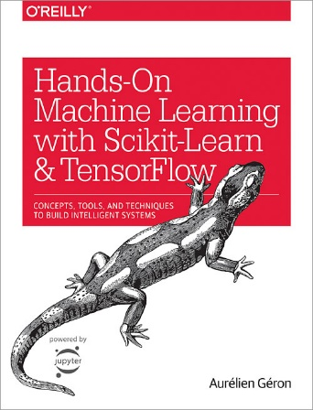
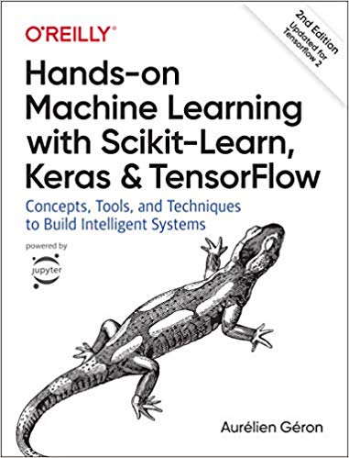
Learning TensorFlow
TensorFlow 1
which we use in these lectures
TensorFlow 2
significantly different API
released October 2019

Slide 103
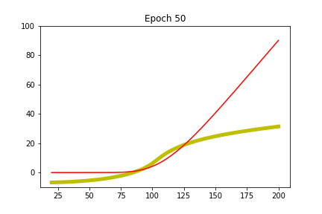
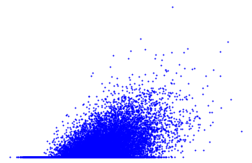
Learn pricing from simulated data
Simulation under risk-neutral probability Q in some arbitrary model
x = state at time t1, including:
model state example: spot
product state example: is barrier hit?
y = payoff at time t2>t1
For an ML model, correctly trained to minimize MSE on this data, we saw that:
which is, indeed, the theoretical price at t1
Hinting that pricing can be learned from samples alone
max(S2-K,0)
S1
Example: European call in Black & Scholes
True solution: Black & Scholes’ formula
For reference and assessment only
The model only learns from the samples

Slide 104
Learn pricing from simulated data
2 Python notebooks, packaged as articles with code:
GitHub.com/aSavine/CompFinLecture/MLFinance/
BlackScholesCall.ipynb and BachelierBasket.ipynb
requires an installation of TensorFlow 1.x (not TF 2 – latest = 1.14 at the time of writing)
these notebooks are basically articles (with code) and may also be read (but not executed) without TensorFlow
new : you may also run the notebooks directly on Google colab – in the cloud (on GPU!) on with no installation required
https://colab.research.google.com/drive/1e2mjezSWXPoVpt9E7iiWPsrdig8j-Kzl
and
https://colab.research.google.com/drive/18oeWIa_w0q7fMLb9rtsymMMe3hcQFFK_

Slide 105
Conclusion
We studied in detail the fundamental machinery of feed-forward and back-propagation
There is a lot more to deep learning:
Speed and accuracy improvements: regularization, dropout, batch-norm, stochastic gradient descent, etc.
Convolutional nets with many impressive applications in computer vision
Recurrent nets with many impressive applications in natural language processing (NLP) And also time series forecasting, proprietary trading strategies, etc.
Reinforcement learning, leveraging DL to learn strategies for playing games, driving cars or trading currencies
Deep learning is here to stay
Overhyped due to recent successes in computer vision, NLP and chess/go --- hype will fade
This being said, DL genuinely offers efficient, elegant solutions to otherwise intractable problems in finance and elsewhere
DL will not replace financial models but it will be part of the financial quant toolbox
Financial quants and derivatives professionals cannot ignore it

Slide 106
AD through evaluation graphs

Slide 107
Computation graphs and adjoint propagation
We have seen back-propagation through computation graphs of neural nets:
in this section , g are ops and g’ are their (known) Jacobians --- not activations (we are no longer in Deep Learning)
In this section, we:
Illustrate that any scalar calculation defines a computation graph, same as neural nets
Therefore back-prop may compute efficiently the differentials of any scalar result
With the example of Black & Scholes’ formula
And conclude with important remarks regarding op granularity and control flow
feed-forward computation:
graph = sequence of ops
reverse adjoint differentiation:

Slide 108
Example: Black & Scholes
Black & Scholes’ formula: with
Discount factor to maturity:
Forward:
Standard deviation:
Log-moneyness:
D’s:
Probabilities to end in the money, resp. under spot and risk-neutral measures:
Call price:

Slide 109
Black & Scholes: computation graph
Inputs
Temp. calc.
Temp. calc.
Temp. calc.
Temp. calc.
Result
Input layer l=0
Hidden layer l=1
Hidden layer l=2
Hidden layer l=3
Hidden layer l=4
Output layer l=5

Slide 110
Ops
Like deep nets, any calculation is defined by its graph:
In our Black & Scholes example, we defined the sequence of ops:

Slide 111
Jacobians
For any calculation, we can compute the differentials of the result to the inputs:
By splitting the calculation into ops g, with known Jacobians
In our Black & Scholes example:
Note that the Jacobian of the output layer is a vector, hence a gradient, as with any scalar calculation

Slide 112
Adjoint equations
We have identified the calculation graph with its sequence of ops g and their Jacobians g’
We have run it once and stored all the intermediate results a
We may now compute all the derivatives of in constant time by back-prop:
Seed
Back-prop
Result
Not that interesting with Black & Scholes: only 6 inputs/derivatives: delta, vega, rho, …
But the exact same algorithm applies with large evaluations taking 6,000 inputs --- very interesting then
Exercise: unroll back-prop in the Black & Scholes’ example and show that the results are the (well known) “Greeks”

Slide 113
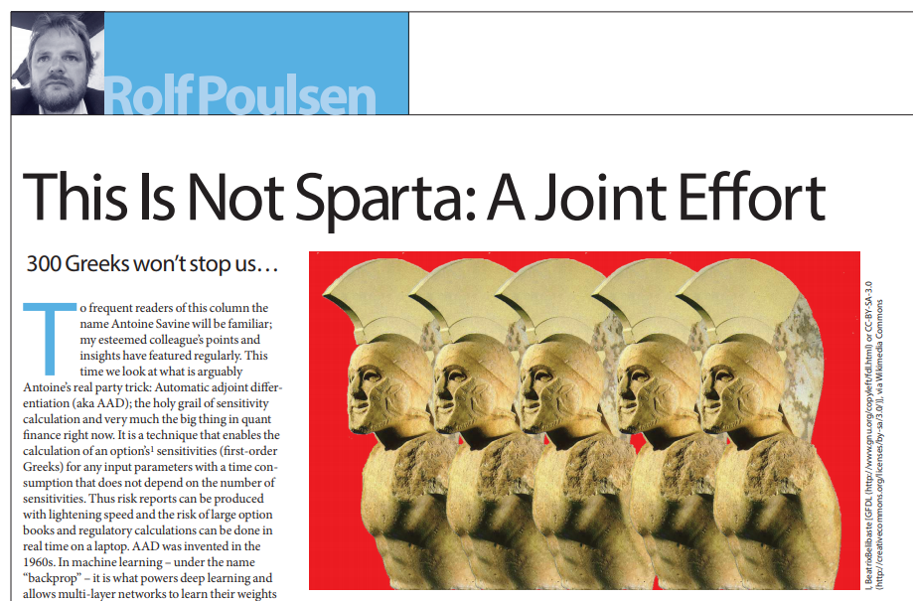
“Atomic” ops
What we just did is:
Split a calculation
Into a sequence of simpler calculations
Then, we applied back-propagation to compute derivatives
Pushing this logic to limit, we will:
Split any calculation into a sequence of “atomic” ops: +, -, *, /, pow(), exp(), log(), sqrt(), sin(), cos(), …
Then, we have a very limited number of building block ops (about 20 in total, try to count them)
And, yet, any numerical calculation is, always, a (long) sequence of these 20-something building blocks!
This is another mind-twisting fact about AAD see Rolf Poulsen’s Wilmott article: antoinesavine.files.wordpress.com/2018/12/poulsen-2018-wilmott.pdf
For these 20-something building blocks, we know the derivatives g’ : exp’ = exp, log’ = 1/x, sqrt’ = 1 / 2sqrt, etc.
Therefore, we can hard-code these 20-something derivatives once and for all, and fully automate back-prop ➔ this is AAD

Slide 114
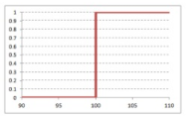
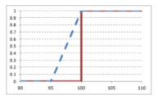
Control flow
“It is a somewhat vertiginous realization that any calculation, like the Monte-Carlo estimate of the counterparty credit value adjustment on a netting set of thousands of exotic transactions, is still a sequence of elementary operations. A very, very long sequence, but a sequence all the same. “
Rolf Poulsen
Mathematical equations are more than sequences of building blocks We also have limits, differentials, integrals, etc.
But their numerical implementation is always nothing more, nothing less than a sequence of building block ops…
… and control flow, also called branching: “if this then that” statements
Control flow makes functions discontinuous, hence, not differentiable
Attempts to differentiate control flow with bumping results into instabilities
AD/AAD computes exact differentials – same as infinitesimal bumps
So derivatives are always taken on the same side of the control flow, and never through control flow
This is not always the desired result, so something to take into account
Best solution is smoothing, see slideshare.net/AntoineSavine/stabilise-risks-of-discontinuous-payoffs-with-fuzzy-logic
f(x) = 1 if x > 100, else 0
after bump
before bump
after bump
before bump
before bump
after bump
Smoothing
Approx f by close continuous func
Instabilities/incorrectness vanish

Slide 115
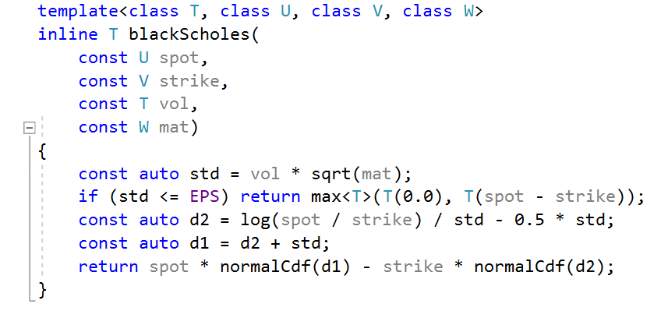
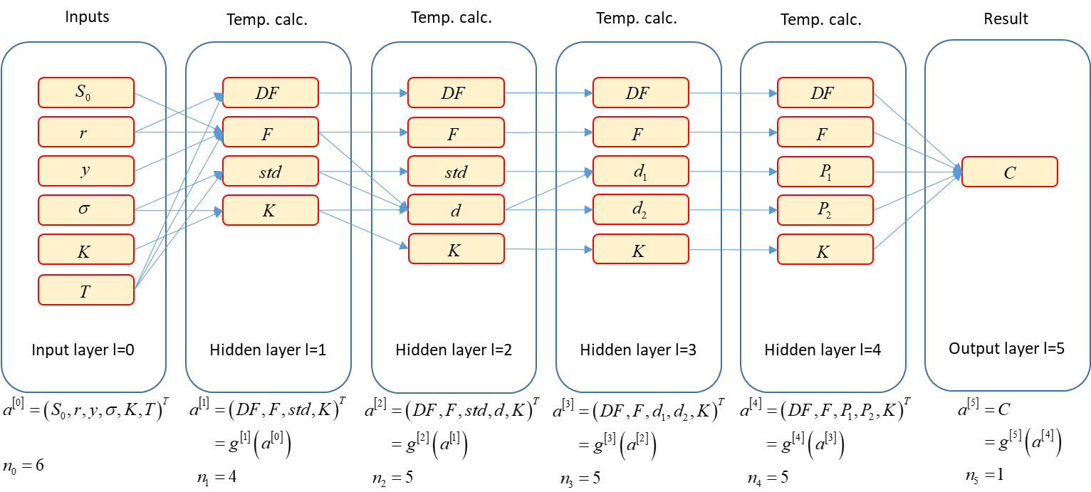
Conclusion
All calculations define a graph, down to 20-something “atomic” ops gs
Like deep nets, all those evaluation graphs may be arranged in successive layers, each an op g of the previous one (with known Jacobians g’):
Once the evaluation graph and its ops g are known, along with their Jacobians g’ (and the forward pass was executed once so all intermediate results a were stored)
All derivatives can be computed in constant time by back-prop
All that remains is to figure the graph from some arbitrary calculation code
AAD
we don’t know yet how to do that
back-prop (AD)
that, we know already
all derivatives,
with analytic accuracy,
and in constant time
code
graph

Slide 116
Recording calculations on tape

Slide 117
C++ code
From there on, we work with C++ code
We write simplistic, beginner level C++
We show AAD can still be implemented with rather spectacular results
We refer to the curriculum for a professional, generic, parallel, efficient implementation
For convenience, we export the C++ functions to Excel for test and visualization
There is a tutorial for doing this: sites.google.com/view/antoinesavine-cpp2xl
All the code in these slides is freely available on GitHub GitHub.com/aSavine
professional code repo: CompFinance
C++ to Excel tutorial with all necessary files: xlCppTutorial
toy code repo: CompFinLecture/ToyAAD
main code for AAD, and instrumentation of Dupire’s model: toyCode.h
utilities: gaussians.h, interp.h, matrix.h
random numbers: random.h, mrg32k3a.h, sobol.h, sobol.cpp

Slide 118
Automatic differentiation
Finite differences
Computes derivatives by running evaluation repeatedly
Only requires executable evaluation code
Linear complexity in the number of differentials, due to repetition of evaluation for every differential
Adjoint Differentiation
Computes derivatives with back-prop in reverse order over an evaluation graph
Requires a graph to traverse -- executable code is not enough
Constant complexity in the number of differentials : efficient differentiation of scalar code
With AD, we must extract an evaluation graph: sequence of ops (nodes) and their dependencies (edges)

Slide 119
Graph extraction
Explicit graph construction
Solution implemented in TensorFlow
Lets clients explicitly build graphs by calling graph graph creation functions exported to many languages
Then use a TF session to evaluate or differentiate the graphs efficiently: run forward and backward passes, on multicore CPU or GPU
Smart and efficient
But forces developers to explicitly build graphs in place of calculation code
(TensorFlow has a nice API that makes building graphs somewhat similar to coding calculations)
But what we want here is take some arbitrary calculation code and automatically extract its graph
Source transformation
Code that reads and understands evaluation code, then builds graphs and writes backward differentiation code automatically
Complex, specialized work similar to writing compilers
Variant: template meta-programming and introspection (chapter 15 of curriculum)

Slide 120
Operator overloading
Alternative: operator overloading (in languages that support it like C++)
When code applies operators (like + or *) or math functions (like log or sqrt) to real numbers (double type) the corresponding operations are evaluated immediately (or eagerly):
When the same operators are applied to custom types (our own type to store real numbers) we decide exactly what happens:
double x = 1, y = 2; // x and y are doubles
double z = x + y; // evaluates x + y and stores result in z
double t = log(x); // evaluates log(x) and stores result in t
class myNumberType
{
// class definition here
};
myNumberType operator+(const myNumberType& lhs, const myNumberType& rhs)
{
// this code is executed anytime two numbers of type myNumberType are added
}
myNumberType log(const myNumberType& arg)
{
// this code is executed anytime log is called on a number of type myNumberType
}
myNumberType x, y; // x and y are of type myNumberType
myNumberType z = x + y; // executes code in the overloaded operator+()
myNumberType t = log(x); // executes code in the overloaded log()

Slide 121
Recording operations
We apply operator overloading to record all operations along with their dependencies:
class myNumberType
{
myNumberType(const double x)
{
// constructor initializes value to x and records node
}
};
myNumberType operator+(const myNumberType& lhs, const myNumberType& rhs)
{
recordAddition(lhs, rhs); // records addition with dependency on lhs and rhs
}
myNumberType log(const myNumberType& arg)
{
recordLog(arg); // records log with dependency on arg
}
myNumberType x = 1, y = 2; // initializes x to 1 and y to 2 and records them
myNumberType z = x + y; // records addition with dependencies on x and y
myNumberType t = log(x); // records log with dependency on x
myNumberType result = t + z; // records addition with dependency on t and z

Slide 122
Lazy evaluation
When this code is executed:
Nothing is calculated, instead the following graph is recorded in memory:
This sequence can be evaluated later (lazy evaluation) or differentiated (applying AD from back to front)
This is how we build the evaluation graph at run time, by executing calculation code with a custom type for which operators are overloaded to perform recording
myNumberType x = 1, y = 2; // initializes x to 1 and y to 2 and records them
myNumberType z = x + y; // records addition
myNumberType t = log(x); // records log
myNumberType result = t + z; // records addition
value 1
value 2
+
log
+
x
y
z
t
result

Slide 123
Conventional implementation
We introduce the conventional implementation of AAD
Where every math operation: +, -, *, /, pow, log, exp, sqrt, … is recorded on a data structure called tape
(It is really an evaluation graph but we call it “tape” in AAD lingo)
Cutting-edge implementation records whole expressions
With template meta-programming and expression templates
Resulting in 2x to 5x faster code
Sometimes called “tape compression”
Extreme instance: “tapeless AD” where we don’t record anything!
All implemented in professional code on GitHub and explained in detail in chapter 15
In this presentation, we stick with simpler, conventional implementation
We record every mathematical operation involved in a calculation
Every calculation, up to complex Monte-Carlo simulations, is a sequence of +, -, *, /, pow, log, exp, sqrt, … !
We record every single one
Note that all operations have either 0, 1 or 2 arguments

Slide 124
Simplistic implementation
In this presentation, we focus on the simplicity of the code
We use basic C++ code and disregard efficiency, scalability and best practice
Our aim is to explain the key ideas with simplistic code
This code works, just not efficiently, and it doesn’t scale
In the curriculum, on the contrary, we build professional, scalable, efficient code in modern C++
This is particularly important for AAD because of:
Recording overhead
Every addition, multiplication, etc. produces a record
Recording necessarily involves an overhead
An efficient implementation must minimize overhead and make recording as efficient as possible
Vast memory consumption
We store in memory all the operations involved in a large calculation, this is a very large number of records
Estimated RAM consumption around 5GB per second
Efficient memory and cache management are key to an efficient implementation
An efficient implementation of conventional AAD is given and explained in chapter 10
Effective, custom memory management
Recording with minimum overhead, cache efficiency and so on

Slide 125
Record and tape data structures
A record
Stores one operation
Knows the number and location of the 0, 1 or 2 arguments
Stores the 0, 1 or 2 partial derivatives to its arguments so we can apply AD
The tape stores the sequence of records
struct Record
{
int numArg; // number of arguments: 0, 1 or 2
int idx1; // index of first argument on tape
int idx2; // index of second argument on tape
double der1; // partial derivative to first argument
double der2; // partial derivative to second argument
};
// The tape, declared as a global variable
vector<Record> tape;

Slide 126
Custom real number
Our custom number
Holds its value and
Knows the index of the corresponding operation on tape
May be initialized with a value to create a record (without arguments) on tape
We overload all mathematical operators and functions to:
Evaluate and store result as usual
Additionally, record the operation and its derivatives on tape
So code is evaluated and recorded at the same time
Number operator+(const Number& lhs, const Number&rhs)
{
// create a new record on tape
tape.push_back(Record());
Record& rec = tape.back();
// compute result
Number result;
result.value = lhs.value + rhs.value; // calling double overload
// reference record on tape
result.idx = tape.size() - 1;
// populate record on tape
rec.numArg = 2;
rec.idx1 = lhs.idx;
rec.idx2 = rhs.idx;
// compute derivatives, both derivatives of addition are 1
rec.der1 = 1;
rec.der2 = 1;
return result;
}
struct Number
{
double value;
int idx;
// default constructor does nothing
Number() {}
// constructs with a value and record
Number(const double& x) : value(x)
{
// create a new record on tape
tape.push_back(Record());
Record& rec = tape.back();
// reference record on tape
idx = tape.size() - 1;
// populate record on tape
rec.numArg = 0;
}
};

Slide 127
Operator overloading
Number operator*(const Number& lhs, const Number&rhs)
{
// ...
// compute value
result.value = lhs.value * rhs.value;
// ...
// compute derivatives
rec.der1 = rhs.value;
rec.der2 = lhs.value;
// ...
}
Similarly, we overload -, *, and /
Same code exactly, only values and derivatives change
Number operator-(const Number& lhs, const Number&rhs)
{
// ...
// compute value
result.value = lhs.value - rhs.value;
// ...
// compute derivatives
rec.der1 = 1;
rec.der2 = -1;
// ...
}
Number operator/(const Number& lhs, const Number&rhs)
{
// ...
// compute value
result.value = lhs.value / rhs.value;
// ...
// compute derivatives
rec.der1 = 1.0 / rhs.value;
rec.der2 = - lhs.value / (rhs.value * rhs.value);
// ...
}

Slide 128
On-class operator overloading
We must also overload +=, -=, *- and /=, as well as unary + and -, on class
The final Number class is therefore:
struct Number
{
double value;
int idx;
// default constructor does nothing
Number() {}
// constructs with a value and record
Number(const double& x) : value(x)
{
// create a new record on tape
tape.push_back(Record());
Record& rec = tape.back();
// reference record on tape
idx = tape.size() - 1;
// populate record on tape
rec.numArg = 0;
}
Number operator +() const { return *this; }
Number operator -() const { return Number(0.0) - *this; }
Number& operator +=(const Number& rhs) { *this = *this + rhs; return *this; }
Number& operator -=(const Number& rhs) { *this = *this - rhs; return *this; }
Number& operator *=(const Number& rhs) { *this = *this * rhs; return *this; }
Number& operator /=(const Number& rhs) { *this = *this / rhs; return *this; }
};

Slide 129
Function overloading
Similarly, we overload log, exp, sqrt
We should really overload all standard math functions
Code is identical for all functions, only value and derivatives change
Number sqrt(const Number& arg)
{
// create a new record on tape
tape.push_back(Record());
Record& rec = tape.back();
// compute result
Number result;
result.value = sqrt(arg.value); // calling double overload
// reference record on tape
result.idx = tape.size() - 1;
// populate record on tape
rec.numArg = 1;
rec.idx1 = arg.idx;
// compute derivative
rec.der1 = 0.5 / result.value;
return result;
}
Number exp(const Number& arg)
{
// create a new record on tape
tape.push_back(Record());
Record& rec = tape.back();
// compute result
Number result;
result.value = exp(arg.value);
// reference record on tape
result.idx = tape.size() - 1;
// populate record on tape
rec.numArg = 1;
rec.idx1 = arg.idx;
// compute derivative
rec.der1 = result.value;
return result;
}
Number log(const Number& arg)
{
// create a new record on tape
tape.push_back(Record());
Record& rec = tape.back();
// compute result
Number result;
result.value = log(arg.value);
// reference record on tape
result.idx = tape.size() - 1;
// populate record on tape
rec.numArg = 1;
rec.idx1 = arg.idx;
// compute derivative
rec.der1 = 1.0 / arg.value;
return result;
}

Slide 130
Custom function overloading
Also overload building blocks that are not standard to C++ but frequently applied in applications
In financial application, we use cumulative normal distributions and normal densities all the time
The functions are defined in the file gaussians.h in the repo
We overload here (once again, only change is in value and derivatives):
Number normalDens(const Number& arg)
{
// create a new record on tape
tape.push_back(Record());
Record& rec = tape.back();
// compute result
Number result;
result.value = normalDens(arg.value);
// reference record on tape
result.idx = tape.size() - 1;
// populate record on tape
rec.numArg = 1;
rec.idx1 = arg.idx;
// compute derivative
rec.der1 = - result.value * arg.value;
return result;
}
Number normalCdf(const Number& arg)
{
// create a new record on tape
tape.push_back(Record());
Record& rec = tape.back();
// compute result
Number result;
result.value = normalCdf(arg.value); // calling double overload in gaussians.h
// reference record on tape
result.idx = tape.size() - 1;
// populate record on tape
rec.numArg = 1;
rec.idx1 = arg.idx;
// compute derivative
rec.der1 = normalDens(arg.value);
return result;
}

Slide 131
Avoiding code duplication
The code for all binary operators and for all unary functions is identical
Only values and derivatives are different
This is poor design: If we change something in the logic, we must consistently modify many different functions
In the professional code of chapters 10 and 15 we structure code and apply “policy design” (Alexandresku, 2001) to avoid duplication without overhead
Here, we stick with duplicated code

Slide 132
Comparison operator overloading
Our custom number must do everything a double does
In particular, we must be able to compare two Numbers
Hence, to complete our simple framework, we must also overload comparison operators:
bool operator==(const Number& lhs, const Number& rhs) { return lhs.value == rhs.value; }
bool operator!=(const Number& lhs, const Number& rhs) { return lhs.value != rhs.value; }
bool operator>(const Number& lhs, const Number& rhs) { return lhs.value > rhs.value; }
bool operator>=(const Number& lhs, const Number& rhs) { return lhs.value >= rhs.value; }
bool operator<(const Number& lhs, const Number& rhs) { return lhs.value < rhs.value; }
bool operator<=(const Number& lhs, const Number& rhs) { return lhs.value <= rhs.value; }

Slide 133
Applying the recording framework
Our simple recording framework is complete, see complete code in the GitHub repo, file toyCode.h
We may use it to record calculations
Example: Black and Scholes
inline double blackScholes(
// input layer 0
const double spot, const double rate, const double yield, const double vol, const double strike, const double mat)
{
/* layer 1 */ double df = exp(-rate * mat), fwd = spot * exp((rate - yield) * mat), std = vol * sqrt(mat);
/* layer 2 */ double d = log(fwd / strike) / std;
/* layer 3 */ double d1 = d + 0.5 * std, d2 = d - 0.5 * std;
/* layer 4 */ double p1 = normalCdf(d1), p2 = normalCdf(d2);
/* output layer 5 */ return df * (fwd * p1 - strike * p2);
}

Slide 134
Instrumenting computation code
To record a Black & Scholes calculation, we must call it with our number type
This is called instrumentation
We can replace all doubles by Numbers:
inline Number blackScholes(
// input layer 0
const Number spot, const Number rate, const Number yield, const Number vol, const Number strike, const Number mat)
{
/* layer 1 */ Number df = exp(-rate * mat), fwd = spot * exp((rate - yield) * mat), std = vol * sqrt(mat);
/* layer 2 */ Number d = log(fwd / strike) / std;
/* layer 3 */ Number d1 = d + 0.5 * std, d2 = d - 0.5 * std;
/* layer 4 */ Number p1 = normalCdf(d1), p2 = normalCdf(d2);
/* output layer 5 */ return df * (fwd * p1 - strike * p2);
}

Slide 135
Instrumenting computation code
Better solution: template code on number representation type
Best practice: produce templated code in the first place
To evaluate only, call with doubles as arguments
To evaluate and record code, call with Numbers as arguments
template <class T> inline T blackScholes(
// input layer 0
const T spot, const T rate, const T yield, const T vol, const T strike, const T mat)
{
/* layer 1 */ T df = exp(-rate * mat), fwd = spot * exp((rate - yield) * mat), std = vol * sqrt(mat);
/* layer 2 */ T d = log(fwd / strike) / std;
/* layer 3 */ T d1 = d + 0.5 * std, d2 = d - 0.5 * std;
/* layer 4 */ T p1 = normalCdf(d1), p2 = normalCdf(d2);
/* output layer 5 */ return df * (fwd * p1 - strike * p2);
}
double spot = 100, rate = 0.02, yield = 0.05, vol = 0.2, strike = 110, mat = 2; // initializes inputs
auto result = blackScholes(spot, rate, yield, vol, strike, mat); // evaluates operations
Number spot = 100, rate = 0.02, yield = 0.05, vol = 0.2, strike = 110, mat = 2; // initializes and records inputs
auto result = blackScholes(spot, rate, yield, vol, strike, mat); // evaluates and records operations

Slide 136
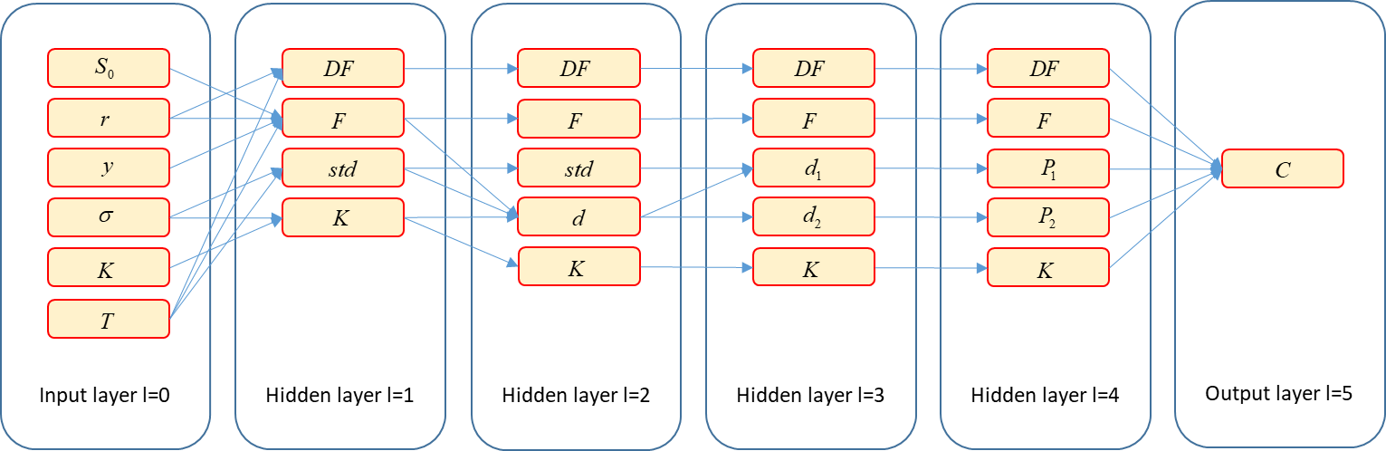
Tape vs graph
Operator overloading gives us a tape of the mathematical operations involved in a calculation
After execution of the templated code for Black & Scholes, we get the following tape:
A tape is not exactly the same as an evaluation graph, where operations are neatly arranged by layer:
Where we recall that operator overloading also gave us:
The operations from ancestors A (arguments) to successors S (results)
And their derivatives

Slide 137
Tape vs graph (2)
The tape and the graph express the exact same information, differently
We can always turn a tape into a graph or vice-versa
If we had a graph, we could run back-prop to compute all derivatives in constant time and be done
We could turn our tape into a graph, but this would be a waste of precious computational resources
Instead, we work with a slightly different version of the back-prop/AD algorithm
So we can back-propagate adjoints directly through the tape (although it is not arranged in layers)
Using the notions of ancestor (argument to an operation) and successor (result of an operation)
AAD is the sum of a recording framework (e.g. operator overloading) and back-propagation through the tape

Slide 138
AAD

Slide 139
Ancestors
We call the instrumented instance of our code:
Which evaluates the calculation and records all operations on tape
Denote the operation number i, this is a function of 0, 1 or 2 arguments
The arguments must also be on tape, with indices < i
Denote the set of indices of the ancestors (arguments) to - this is a set of 0, 1 or 2 indices, all < i
Denote n the number of inputs and N the number of operations on tape, including inputs
Denote the result of operation i and the final result
Note that all the local derivatives have been computed and recorded on tape, on evaluation, by our operators
Our tape therefore looks like:
Number spot = 100, rate = 0.02, yield = 0.05, vol = 0.2, strike = 110, mat = 2; // initializes and records inputs
auto result = blackScholes(spot, rate, yield, vol, strike, mat); // evaluates and records operations
cout << result.value; // 5.03705
inputs
operations
…
…
…
result
…
…
…
…
…

Slide 140
Successors
Successors: j is a successor to i if i is an ancestor to j
Denote the set of indices of the successors of on tape
These are the indices i of all functions , calculated after that use as an argument
Formally:
Note that may contain many indices, although the size of is 2 or less
Whereas an empty reveals an unused input or intermediate result
Adjoint equation
Denote the adjoint of
Then (evidently):
And in a direct application of the chain rule: because and we recall that all the are all on tape
…
…
…
…
…
…
…
…

Slide 141
Adjoint accumulation V1
Adjoints therefore satisfy a backward recursion
The last adjoint is given
All other adjoints are a weighted sum of future adjoints: for all j
Hence, the following (flawed) algorithm:
Starting with , compute for every j, in the reverse order, from N-1 to 1:
Summing over the successors of xj:
Problems:
Complexity: a node may have many successors to sum over
Impracticality: ancestors don’t store their successors, it is the successors who store their (up to 2) ancestors and partial derivatives
current j
…
…
…
…
…
…
…
…

Slide 142
Adjoint accumulation V2
A more efficient/practical means of computing the same numbers:
The last adjoint is still given
Initialize all other adjoints to 0
Traverse tape in the reverse order, as previously, accumulating the sum from successors
Problems resolved:
Max complexity 2: a node may have up to 2 ancestors
Successors who store their ancestors and partial derivatives
current i
…
…
…
…
…
…
…
…

Slide 143
Adjoint accumulation algorithm
Initialize all adjoints to 0 and the last adjoint to 1 (this is called seeding the tape):
Repeat for i iterating backwards from N to 0:
The differentials of the calculation to its inputs are, by definition,
This algorithm is called (reverse) adjoint propagation
AAD is the sum of a recording framework and an implementation of adjoint propagation

Slide 144
Adjoint accumulation code
vector<double> calculateAdjoints(Number& result)
{
// initialization
vector<double> adjoints(tape.size(), 0.0); // initialize all to 0
int N = result.idx; // find N
adjoints[N] = 1.0; // seed aN = 1
// backward propagation
for(int j=N; j>0; --j) // iterate backwards over tape
{
if (tape[j].numArg > 0)
{
adjoints[tape[j].idx1] += adjoints[j] * tape[j].der1; // propagate first argument
if (tape[j].numArg > 1)
{
adjoints[tape[j].idx2] += adjoints[j] * tape[j].der2; // propagate second argument
}
}
}
return adjoints;
}

Slide 145
Application to Black & Scholes
After we record a tape by calling the instrumented instance of our code:
We proceed with adjoint propagation:
The code works nicely and produces correct values
Number spot = 100, rate = 0.02, yield = 0.05, vol = 0.2, strike = 110, mat = 2; // initializes and records inputs
auto result = blackScholes(spot, rate, yield, vol, strike, mat); // evaluates and records operations
cout << result.value; // 5.03705
// propagate adjoints
vector<double> adjoints = calculateAdjoints(result);
// show derivatives
cout << "Derivative to spot (delta) = " << adjoints[spot.idx] << endl; // 0.309
cout << "Derivative to rate (rho) = " << adjoints[rate.idx] << endl; // 51.772
cout << "Derivative to dividend yield = " << adjoints[yield.idx] << endl; // -61.846
cout << "Derivative to volatility (vega) = " << adjoints[vol.idx] << endl; // 46.980
cout << "Derivative to strike (-digital) = " << adjoints[strike.idx] << endl; // -0.235
cout << "Derivative to maturity (-theta) = " << adjoints[mat.idx] << endl; // 1.321

Slide 146
Complexity
One evaluation of the calculation
Sweeps forward through the sequence of its operations
Executes every operation exactly once
Therefore its complexity is N, the number of records that end up on tape
Adjoint propagation
Also sweeps through the sequence of operations, backward
Executes 0, 1 or 2 operations on every record, depending on the number of arguments
Therefore, as advertised, AAD computes all n differentials in constant time
In theory, all differentials are propagated in less than 2x one evaluation
In addition, the calculation must evaluated (and recorded) first so the theoretical upper bound is 3x one evaluation
Due to recording and tape traversal overhead, a good implementation generally produces many differentials in 4x to 10x
Our professional code from chapters 10, 12 and 15 beats the theoretical bound!
Recall from the demonstration, one evaluation = 0.8sec, 1,081 differentials = 1.5sec, less than 2x one evaluation
Due to “selective instrumentation”, a strong optimization, explained, along many others, in chapter 12

Slide 147
Conclusion
We implemented AAD in the simplest possible manner, scratching the surface of possibilities
Part III (Chapters 8 to 15) gives the details of a complete, professional, efficient implementation
How to minimize recording overhead
Efficient memory management constructs
Apply check-pointed AAD to differentiate a calculation piece by piece to mitigate RAM footprint and cache inefficiency
Efficiently differentiate non-scalar calculations that return multiple results
Cutting-edge implementation with template meta-programming and expression templates, faster by 2x to 5x
Parallel implementation
Advise for debugging and optimization
And much more
Still the simplistic code works and produces the correct values
Not very interesting for Black & Scholes
Fast, analytic evaluation
Only 6 differentials to compute
Next, we apply the framework to a barrier option in Dupire Monte-Carlo
Long, complex evaluation
1,081 differentials to compute

Slide 148
AAD for financial simulations

Slide 149
Simple simulation code
We implement a simplistic simulation code for a barrier option in Dupire’s model
Recall local volatility is given in a matrix and bi-linearly interpolated in spot and time
We need the following pieces, which we assume are given here
A matrix class to hold local volatilities (matrix.h in the repo, chapters 1 and 2 in the book)
A bi-linear interpolation function (interp.h in the repo, chapter 6, section 6.4 in the book)
Random number generators to produce independent Gaussian increments (chapters 5 and 6)
The code is templated on the real number representation type

Slide 150
Simulation code, version 1
// Signature
template <class T>
inline T toyDupireBarrierMc(
// Spot
const T S0,
// Local volatility
const vector<T>& spots,
const vector<T>& times,
const matrix<T>& vols,
// Product parameters
const T maturity,
const T strike,
const T barrier,
// Number of paths and time steps
const int Np,
const int Nt,
// Initialized random number generator
RNG& random)
// Implementation
// Initialize
T result = 0;
// double because the RNG is not templated (and doesn't need to be, see chapter 12)
vector<double> gaussianIncrements(Nt);
const T dt = maturity / Nt, sdt = sqrt(dt);
// Loop over paths
for (int i = 0; i < Np; ++i)
{
// Generate Nt Gaussian Numbers
random.nextG(gaussianIncrements);
// Euler’s scheme, step by step
T spot = S0, time = 0;
bool alive = true;
for (size_t j = 0; j < Nt; ++j)
{
// Interpolate volatility
const T vol = interp2D(spots, times, vols, spot, time);
time += dt;
// Simulate return
spot *= exp(-0.5 * vol * vol * dt + vol * sdt * gaussianIncrements[j]);
// Monitor barrier
if (spot > barrier)
{
alive = false;
break;
}
}
// Payoff
if (alive && spot > strike) result += spot - strike;
} // paths
return result / Np;

Slide 151
A simplistic code
This code “does the job” but is not acceptable by professional standards
The code is specific to Dupire’s model and an up & out call, therefore not scalable
To price another product (Asian option, Ratchet option, …) copy the code and change the lines that evaluate payoffs
To price in another model (Heston, SLV, …) copy the code and change the lines that generate the path
End up with many different functions implementing the same simulation logic for different couples of models and products
To modify the simulation logic, consistently change all the functions! This is obviously not viable
Chapter 6 teaches a professional architecture for generic simulation libraries
Encapsulate scenario generation in Model objects
Encapsulate payoff evaluation in Product objects
Encapsulate simulation logic in a generic Monte-Carlo engine
Code every model and every product exactly once, mix and match at run time
We stick with the simplistic code for demonstration purposes

Slide 152
An inefficient code
The code does too much work repeatedly during simulations
Key to efficient Monte-Carlo code: Do as much work as possible once, on initialization, and as little as possible repeatedly, during simulations
Example: we perform an expensive bi-linear interpolation in the innermost loop, for every path, on every time step
We interpolate in spot and time, spot is stochastic (scenario dependent), time is not
Therefore we can (and should) pre-interpolate in time on initialization And perform only 1D interpolations in the innermost loop
Chapter 6 teaches and builds fully optimized code
The code is serial, it executes sequentially on one core
Since even our phones are multi-core today, professional code must be parallel
With Monte-Carlo simulations, it is relatively easy to obtain a speed-up by the number of physical cores
Chapter 3 teaches modern parallel C++, chapter 7 builds a professional parallel simulation library And section 12.5 instruments it with AAD in parallel
For the purpose of demonstration, we stick with the not so efficient, serial version

Slide 153
Smoothing barrier options
Discretely monitored barrier options are discontinuous, their value jumps to 0 at the barrier
Therefore, our code is not differentiable
AAD does not help: it cannot perform the impossible task of differentiating a discontinuous function
With finite differences, barrier risks are unstable, with AAD they are all zero
Find the reason why as an exercise!
Therefore traders always smooth discontinuous transactions (barriers, digitals etc.)
Smoothing = applying a close, continuous approximation in place of the discontinuous function
Smoothing in finance, and its connection to fuzzy logic, are explained in the presentation:
slideshare.net\AntoineSavine\stabilise-risks-of-discontinuous-payoffs-with-fuzzy-logic
Here, we briefly explain the “smooth barrier” algorithm, usually applied on derivatives desks

Slide 154
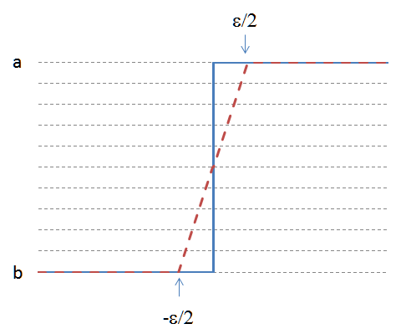
Smooth barrier
Hard barrier
100% dead above the barrier, 100% alive below the barrier
Hence, discontinuous
Soft barrier
100% dead above the barrier plus epsilon, 100% alive below the barrier minus epsilon
In between, lose a fraction of notional interpolated between (barrier-epsilon,0) and (barrier+epsilon,1)
And continue with the remaining notional
Hence, continuous
Smoothing and fuzzy logic
Like Schrodinger’s cat, the transaction is in a superposition of dead and alive states
Smoothing is achieved by replacing sharp logic (dead or alive?) by fuzzy logic (how much alive?)
More in the presentation

Slide 155
Simulation code with smooth barrier
template <class T>
inline T toyDupireBarrierMc(
// Spot
const T S0,
// Local volatility
const vector<T>& spots,
const vector<T>& times,
const matrix<T>& vols,
// Product parameters
const T maturity,
const T strike,
const T barrier,
// Number of paths and time steps
const int Np,
const int Nt,
// Smoothing
const T epsilon,
// initialized random number generator
RNG& random)
// Initialize
T result = 0;
// double because the RNG is not templated (and doesn't need to be, see chapter 12)
vector<double> gaussianIncrements(Nt);
const T dt = maturity / Nt, sdt = sqrt(dt);
// Loop over paths
for (int i = 0; i < Np; ++i)
{
// Generate Nt Gaussian Numbers
random.nextG(gaussianIncrements);
// Step by step
T spot = S0, time = 0;
/* bool alive = true; */ T alive = 1.0; // alive is a real number in (0,1)
for (size_t j = 0; j < Nt; ++j)
{
// Interpolate volatility
const T vol = interp2D(spots, times, vols, spot, time);
time += dt;
// Simulate return
spot *= exp(-0.5 * vol * vol * dt + vol * sdt * gaussianIncrements[j]);
// Monitor barrier
/* if (spot > barrier) { alive = false; break; } */
if (spot > barrier + epsilon) { alive = 0.0; break; } // definitely dead
else if (spot < barrier - epsilon) { /* do nothing */ }; // definitely alive
else /* in between, interpolate */ alive *= 1.0 - (spot - barrier + epsilon) / (2 * epsilon);
}
// Payoff paid on surviving notional
/* if (alive && spot > strike) result += spot - strike; */ if (spot > strike) result += alive * (spot - strike);
} // paths
return result / Np;

Slide 156
Simulation code
Our simple code returns the exact same result as the professional code
It is twice slower than the serial version of the professional code
On a octo-core computer, it is 16x slower than the parallel version
Next, we differentiate it with our simple AAD framework

Slide 157
Differentiation
Just like we did for Black & Scholes, to compute differentials, we:
Initialize the inputs as Numbers Which also records them on tape
Call our templated evaluation code, instantiated with the Number type Which performs the evaluation and records operations on tape
Propagate adjoints backwards through the tape
Pick differentials as the adjoints of the parameters

Slide 158
Differentiation code
void toyDupireBarrierMcRisks(
const double S0, const vector<double>& spots, const vector<double>& times, const matrix<double>& vols,
const double maturity, const double strike, const double barrier,
const int Np, const int Nt, const double epsilon, RNG& random,
/* results: value and dV/dS, dV/d(local vols) */ double& price, double& delta, matrix<double>& vegas)
{
// 1. Initialize inputs
Number nS0(S0), nMaturity(maturity), nStrike(strike), nBarrier(barrier), nEpsilon(epsilon);
vector<Number> nSpots(spots.size()), nTimes(times.size());
matrix<Number> nVols(vols.rows(), vols.cols());
for (int i = 0; i < spots.size(); ++i) nSpots[i] = Number(spots[i]);
for (int i = 0; i < times.size(); ++i) nTimes[i] = Number(times[i]);
for (int i = 0; i < vols.rows(); ++i) for (int j = 0; j < vols.cols(); ++j) nVols[i][j] = Number(vols[i][j]);
// 2. Call instrumented evaluation code, which evaluates the barrier option price and records all operations
Number nPrice = toyDupireBarrierMc(nS0, nSpots, nTimes, nVols, nMaturity, nStrike, nBarrier, Np, Nt, nEpsilon, random);
// 3. Adjoint propagation, the exact same code as before, should be encapsulated in a dedicated function
vector<double> adjoints = calculateAdjoints(nPrice);
// 4. Pick results
price = nPrice.value;
delta = adjoints[nS0.idx];
for (int i = 0; i < vols.rows(); ++i) for (int j = 0; j < vols.cols(); ++j) vegas[i][j] = adjoints[nVols[i][j].idx];
}

Slide 159

Testing differentiation
We run the code in the same context as the initial demonstration but with 100,000 paths instead of 500,000
The computer runs out of memory and crashes!
Running AAD on a simulation with 100,000 paths consumes an insane amount of RAM
Even on a computer with enough memory, such large tape is cache inefficient

Slide 160
Solution in principle
Run a series of risks on batches of say, 1024 paths and average in the end
Wipe the tape in between batches
The average of differentials is the differential of the average
So we get the same results while reducing memory footprint to operations recorded over 1,024 paths
With mini-batches of size 1, this is known as “path-wise differentiation”
This is also a particular, and simple case of the general check-pointing algorithm explained in chapter 13

Slide 161
Solution in code
Rename our function DupireRisksMiniBatch(), call it sequentially from a wrapper function
void toyDupireBarrierMcRisks(
const double S0, const vector<double>& spots, const vector<double>& times, const matrix<double>& vols,
const double maturity, const double strike, const double barrier,
const int Np, const int Nt, const double epsilon, RNG& random,
/* results: value and dV/dS, dV/d(local vols) */ double& price, double& delta, matrix<double>& vegas)
{
price = delta = 0;
for (int i = 0; i < vegas.rows(); ++i) for (int j = 0; j < vegas.cols(); ++j) vegas[i][j] = 0;
double batchPrice, batchDelta; matrix<double> batchVegas(vegas.rows(), vegas.cols());
int pathsToGo = Np, pathsPerBatch = 512;
// calculate batch sensitivities sequentially
while (pathsToGo > 0)
{
// wipe tape
tape.clear();
// do mini batch
int paths = min(pathsToGo, pathsPerBatch);
dupireRisksMiniBatch(S0, spots, times, vols, maturity, strike, barrier, paths, Nt, epsilon, random, batchPrice, batchDelta, batchVegas);
// update results
price += batchPrice * paths / Np;
delta += batchDelta * paths / Np;
for (int i = 0; i < vegas.rows(); ++i) for (int j = 0; j < vegas.cols(); ++j) vegas[i][j] += batchVegas[i][j] * paths / Np;
pathsToGo -= paths;
}
}

Slide 162
Performance
With 100,000 paths, 156 steps, we compute the 1,081 differentials in around 7 seconds
This is 1,081 differentials in the time of around 6 evaluations
This is a very remarkable result, especially with such simplistic code
Try it yourself with the toy code in the repo!
This being said, the professional code is around 8 times faster in serial mode, 64 times faster in parallel mode on a octo-core CPU

Slide 163
Professional Financial Libraries

Slide 164
Interactive coding session
We produced toy Monte-Carlo code that works
And even produces many risks with spectacular accuracy and speed
But this is not professional code
Tangled, not scalable to multiple models and products
Inefficient, speed may be easily and substantially improved
Serial
Part II of the curriculum (chapters 4 through 7) teach the design and implementation of modern, professional, scalable, efficient, parallel financial libraries
Professional code from the curriculum in: GitHub.com/aSavine/CompFinance

Slide 165
Interactive coding session (2)
Here, we review the main notions in a simplified context
And refactor our Dupire/barrier code
In an interactive coding session
We work on the code in GitHub.com/aSavine/CompFinLecture/interactiveToyCode with entry point: main code: toyCode.h
In particular, we review, interactively, directly in code, the following:
Generic, scalable simulation code: separation, abstraction, encapsulation (chapters 4, 5, 6)
Efficient Monte-Carlo and pre-processing (chapter 6)
Parallel Monte-Carlo: const-correctness, mutation and race conditions, load balancing (chapters 3 and 7)
Parallel AAD in a simplified architecture (chapter 12)

Slide 166
Thank you for your attention

